Slide 1
POINTER
C Programming

Slide 2
Pointer Variable
Normal variables contain a specific value (direct reference)
Pointers are ‘variables’ whose values are memory addresses (indirect reference)

Slide 3
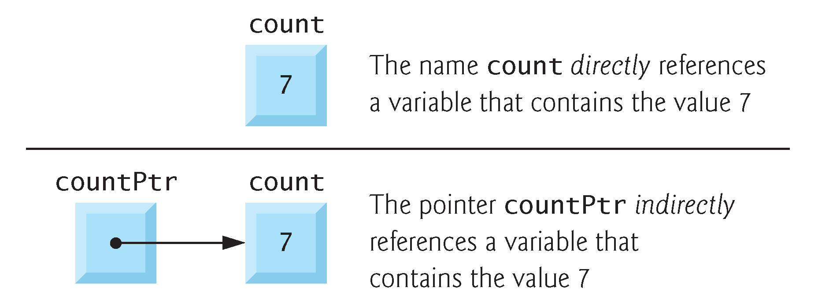

Slide 4
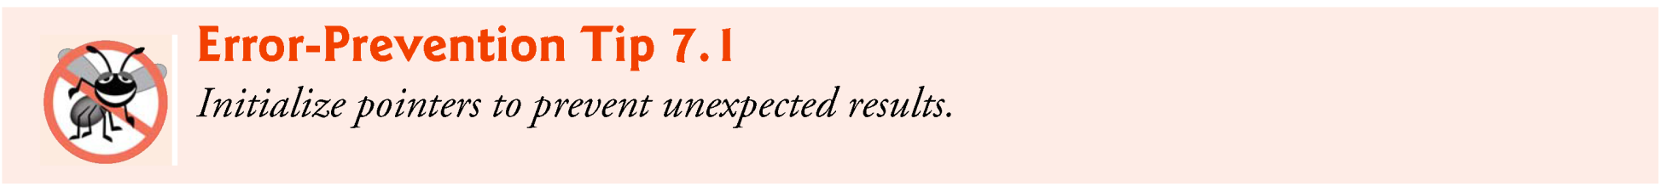
Definitions and Initialization
* used with pointer variables
int *myPtr;
Defines a pointer to an int (pointer of type int *)
Multiple pointers require using a * before each variable definition
int *myPtr1, *myPtr2;
Can define pointers to any data type
Initialize pointers to 0, NULL, or an address
0 or NULL → points to nothing (NULL preferred)

Slide 5
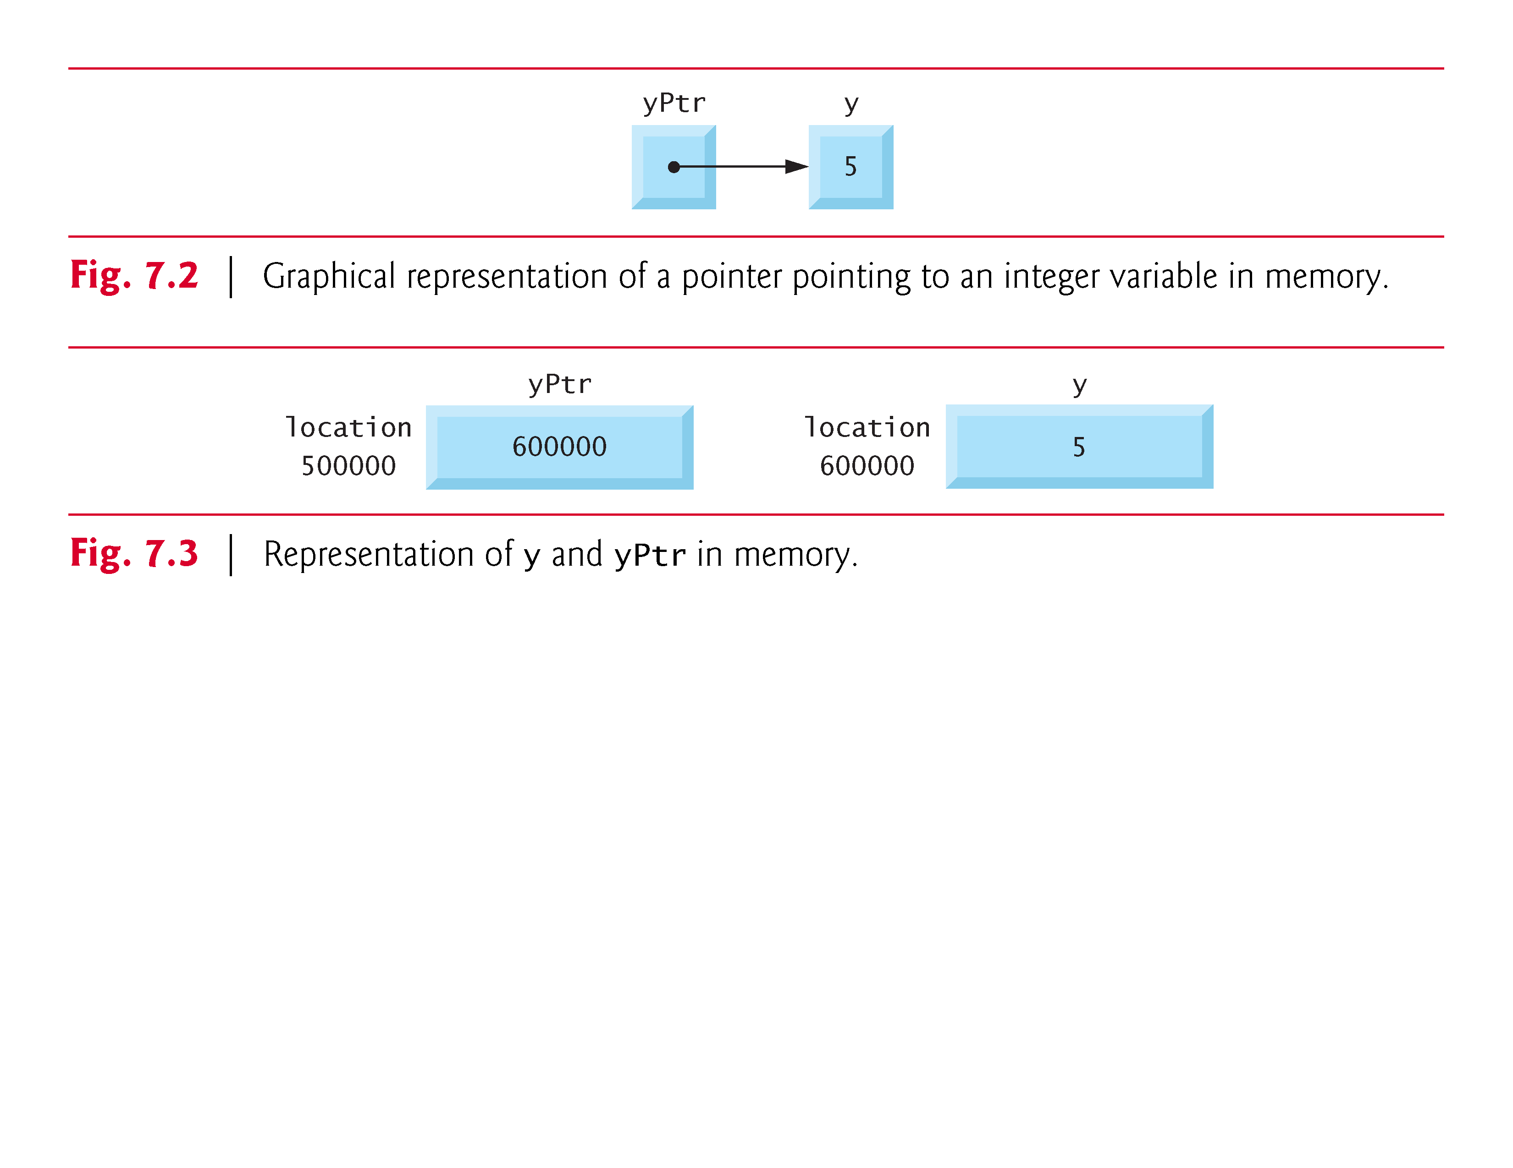
Pointer Operators
int y = 5;
int *yPtr;
yPtr = &y; /* yPtr gets address of y */
yPtr “points to” y

Slide 6
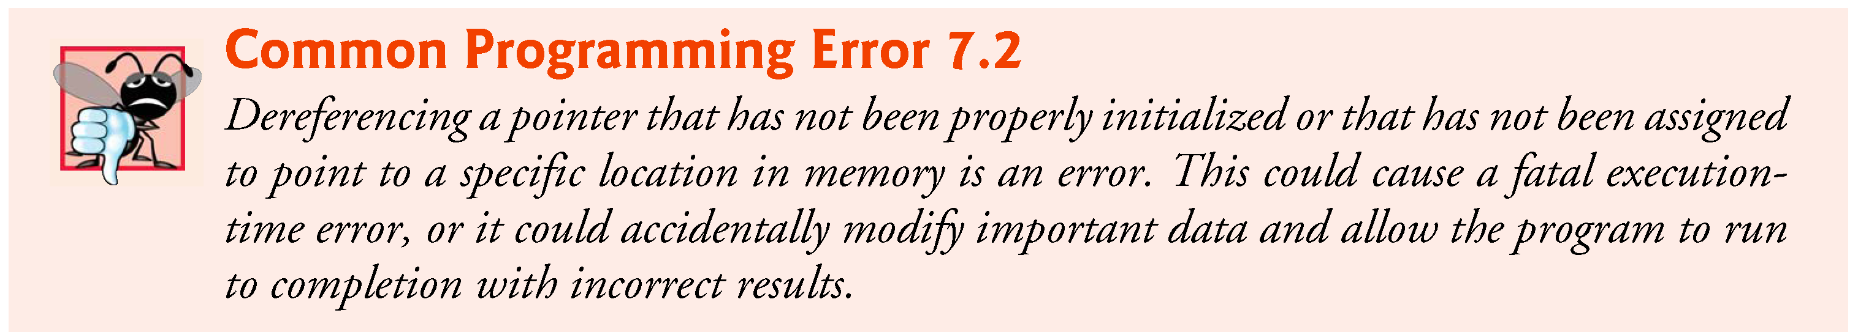
The Indirection (*) Operator
* (indirection/dereferencing operator)
Returns a synonym/alias of what its operand points to
*yptr returns y (because yptr points to y)
* can be used for assignment
Returns alias to an object
*yptr = 7; /* changes y to 7 */
Dereferenced pointer (operand of *) must be an lvalue (no constants)

Slide 7
& Operator VS * Operator
* and & are inverses
They cancel each other out

Slide 8
The address of a is the value of aPtr.
fig07_04.c
The * operator returns an alias to what its operand points to. aPtr points to a, so *aPtr returns a.
Notice how * and & are inverses

Slide 9
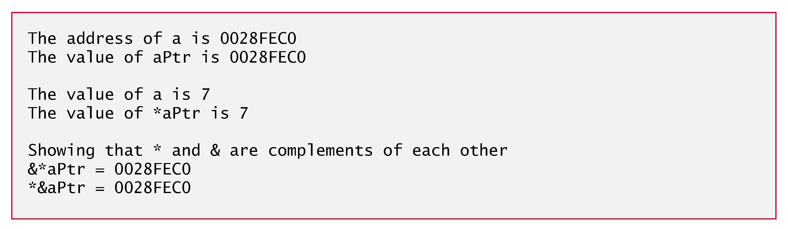

Slide 10
Calling Functions by Reference
Call by reference with pointer arguments
Pass address of argument using & operator
Allows you to change actual location in memory
Arrays are not passed with & because the array name is already a pointer
* operator
Used as alias/nickname for variable inside of function
void double( int *number )
{
*number = 2 * ( *number );
}
*number used as nickname for the variable passed

Slide 11
fig07_06.c

Slide 12
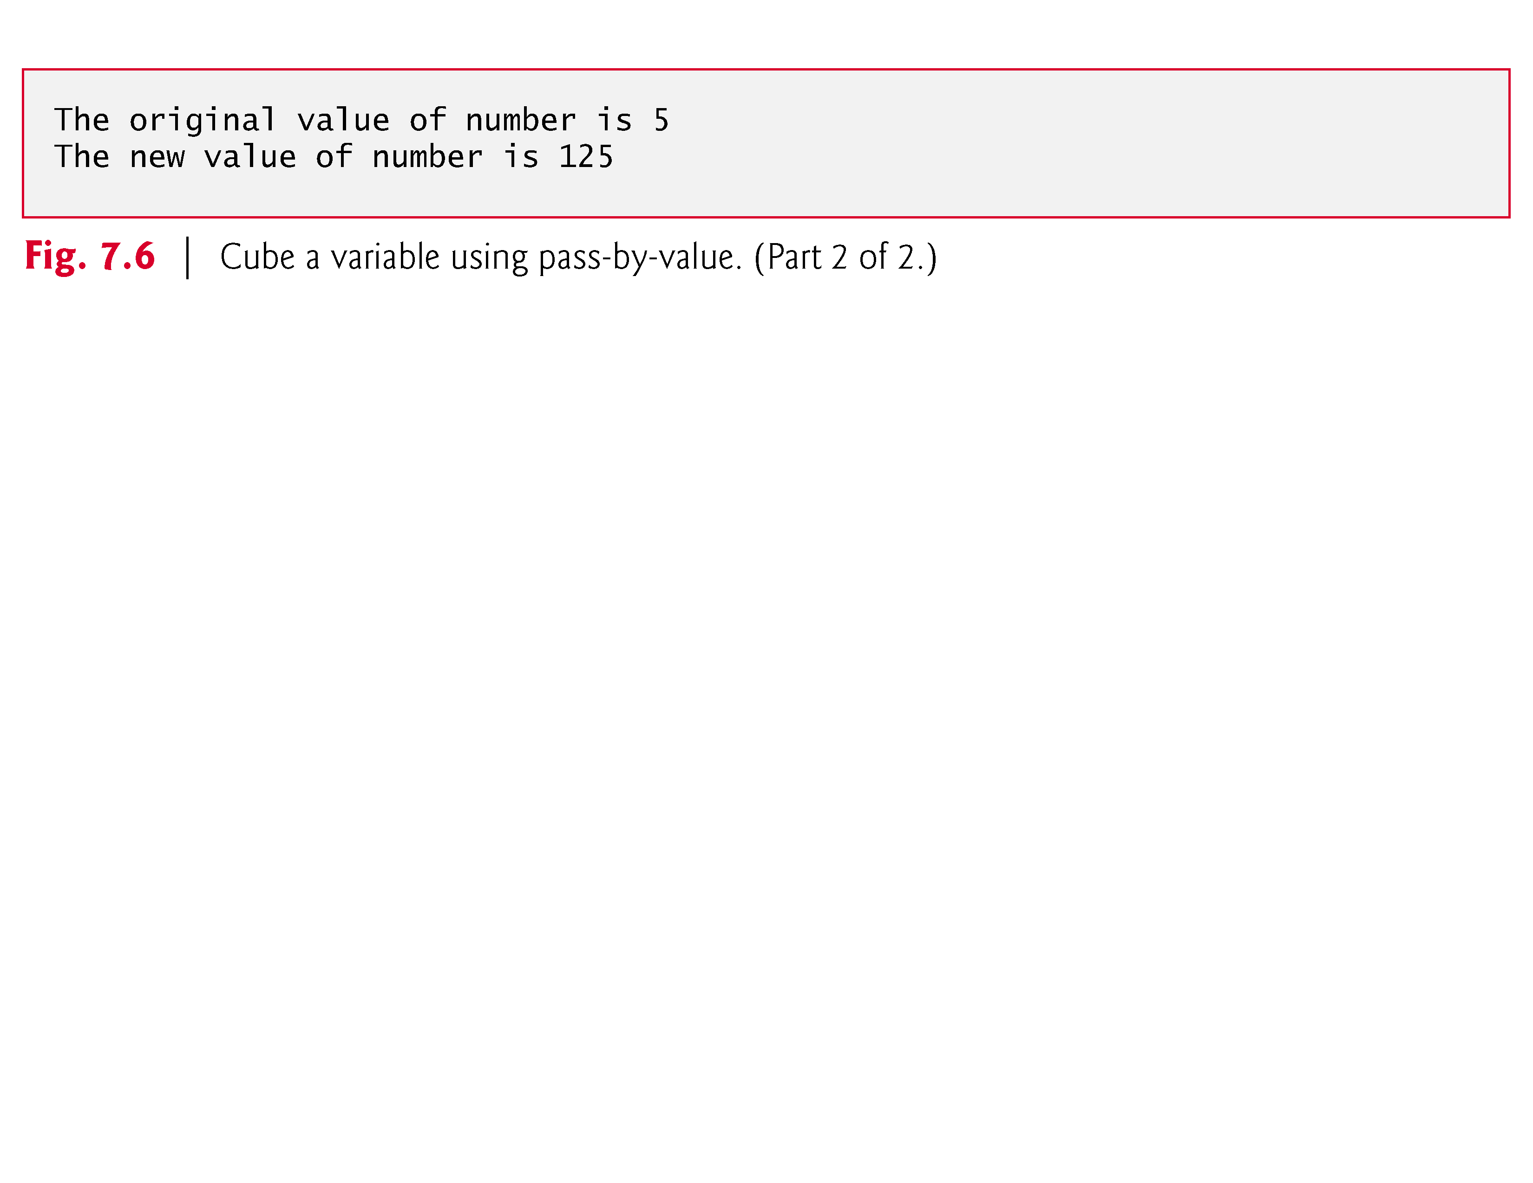

Slide 13
Notice that the function prototype takes a pointer to an integer.
fig07_07.c
Notice how the address of number is given - cubeByReference expects a pointer (an address of a variable).
Inside cubeByReference, *nPtr is used (*nPtr is number).

Slide 14
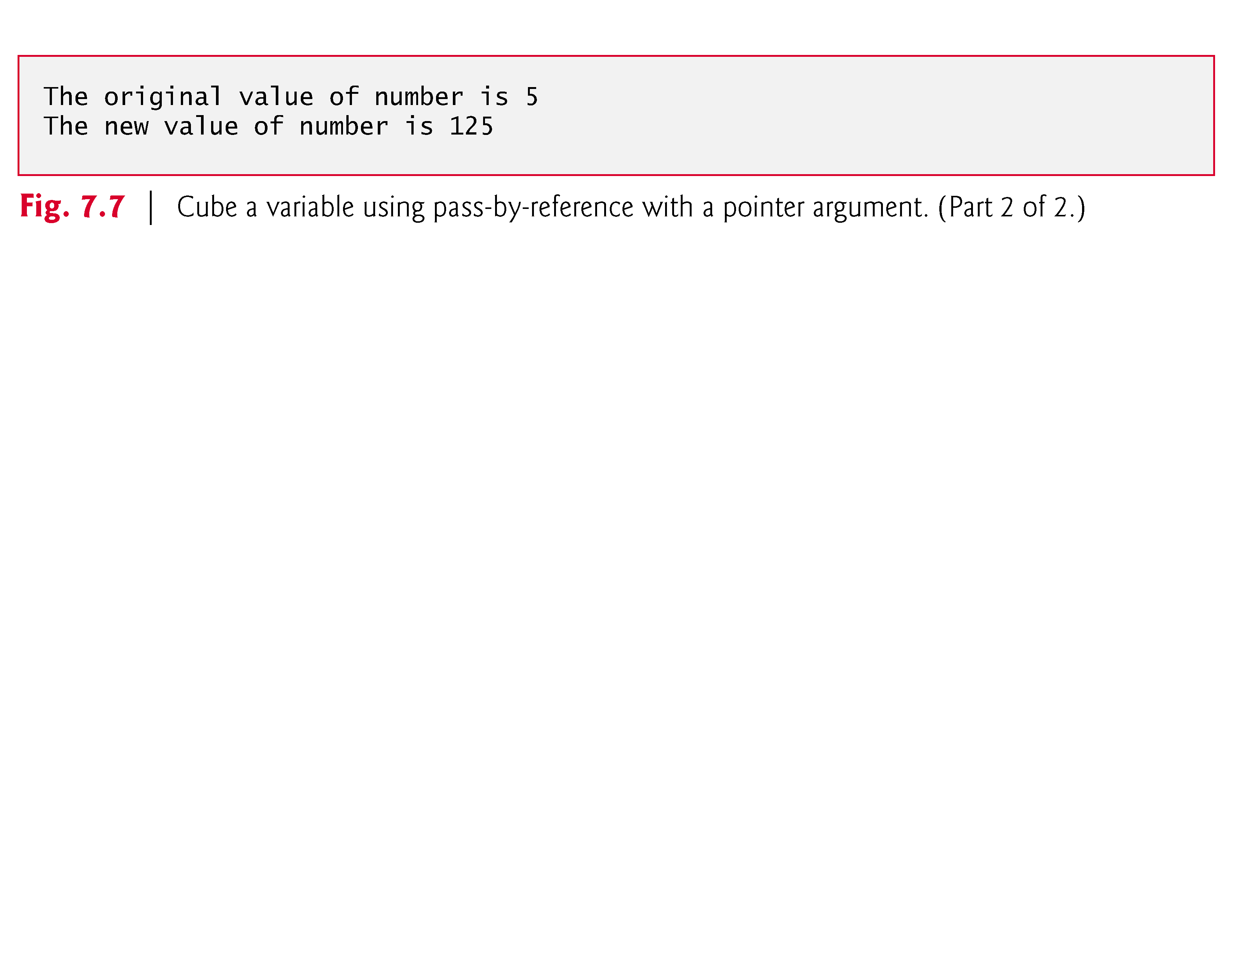

Slide 15
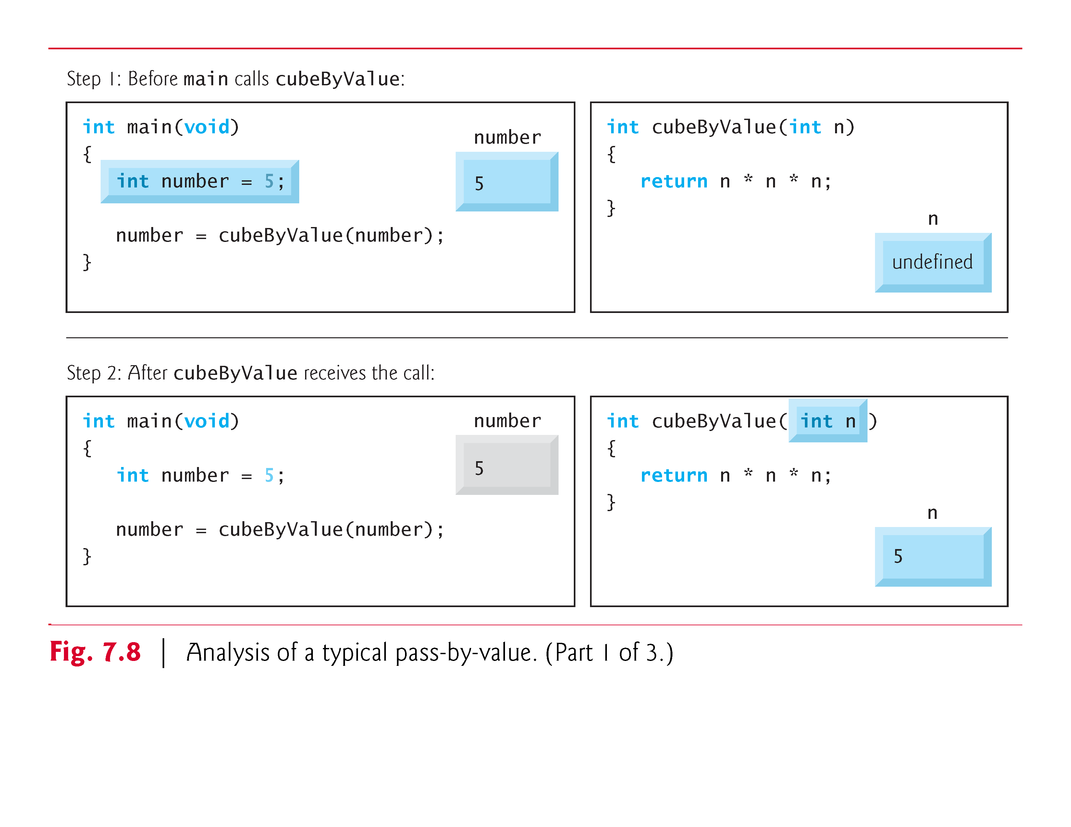

Slide 16
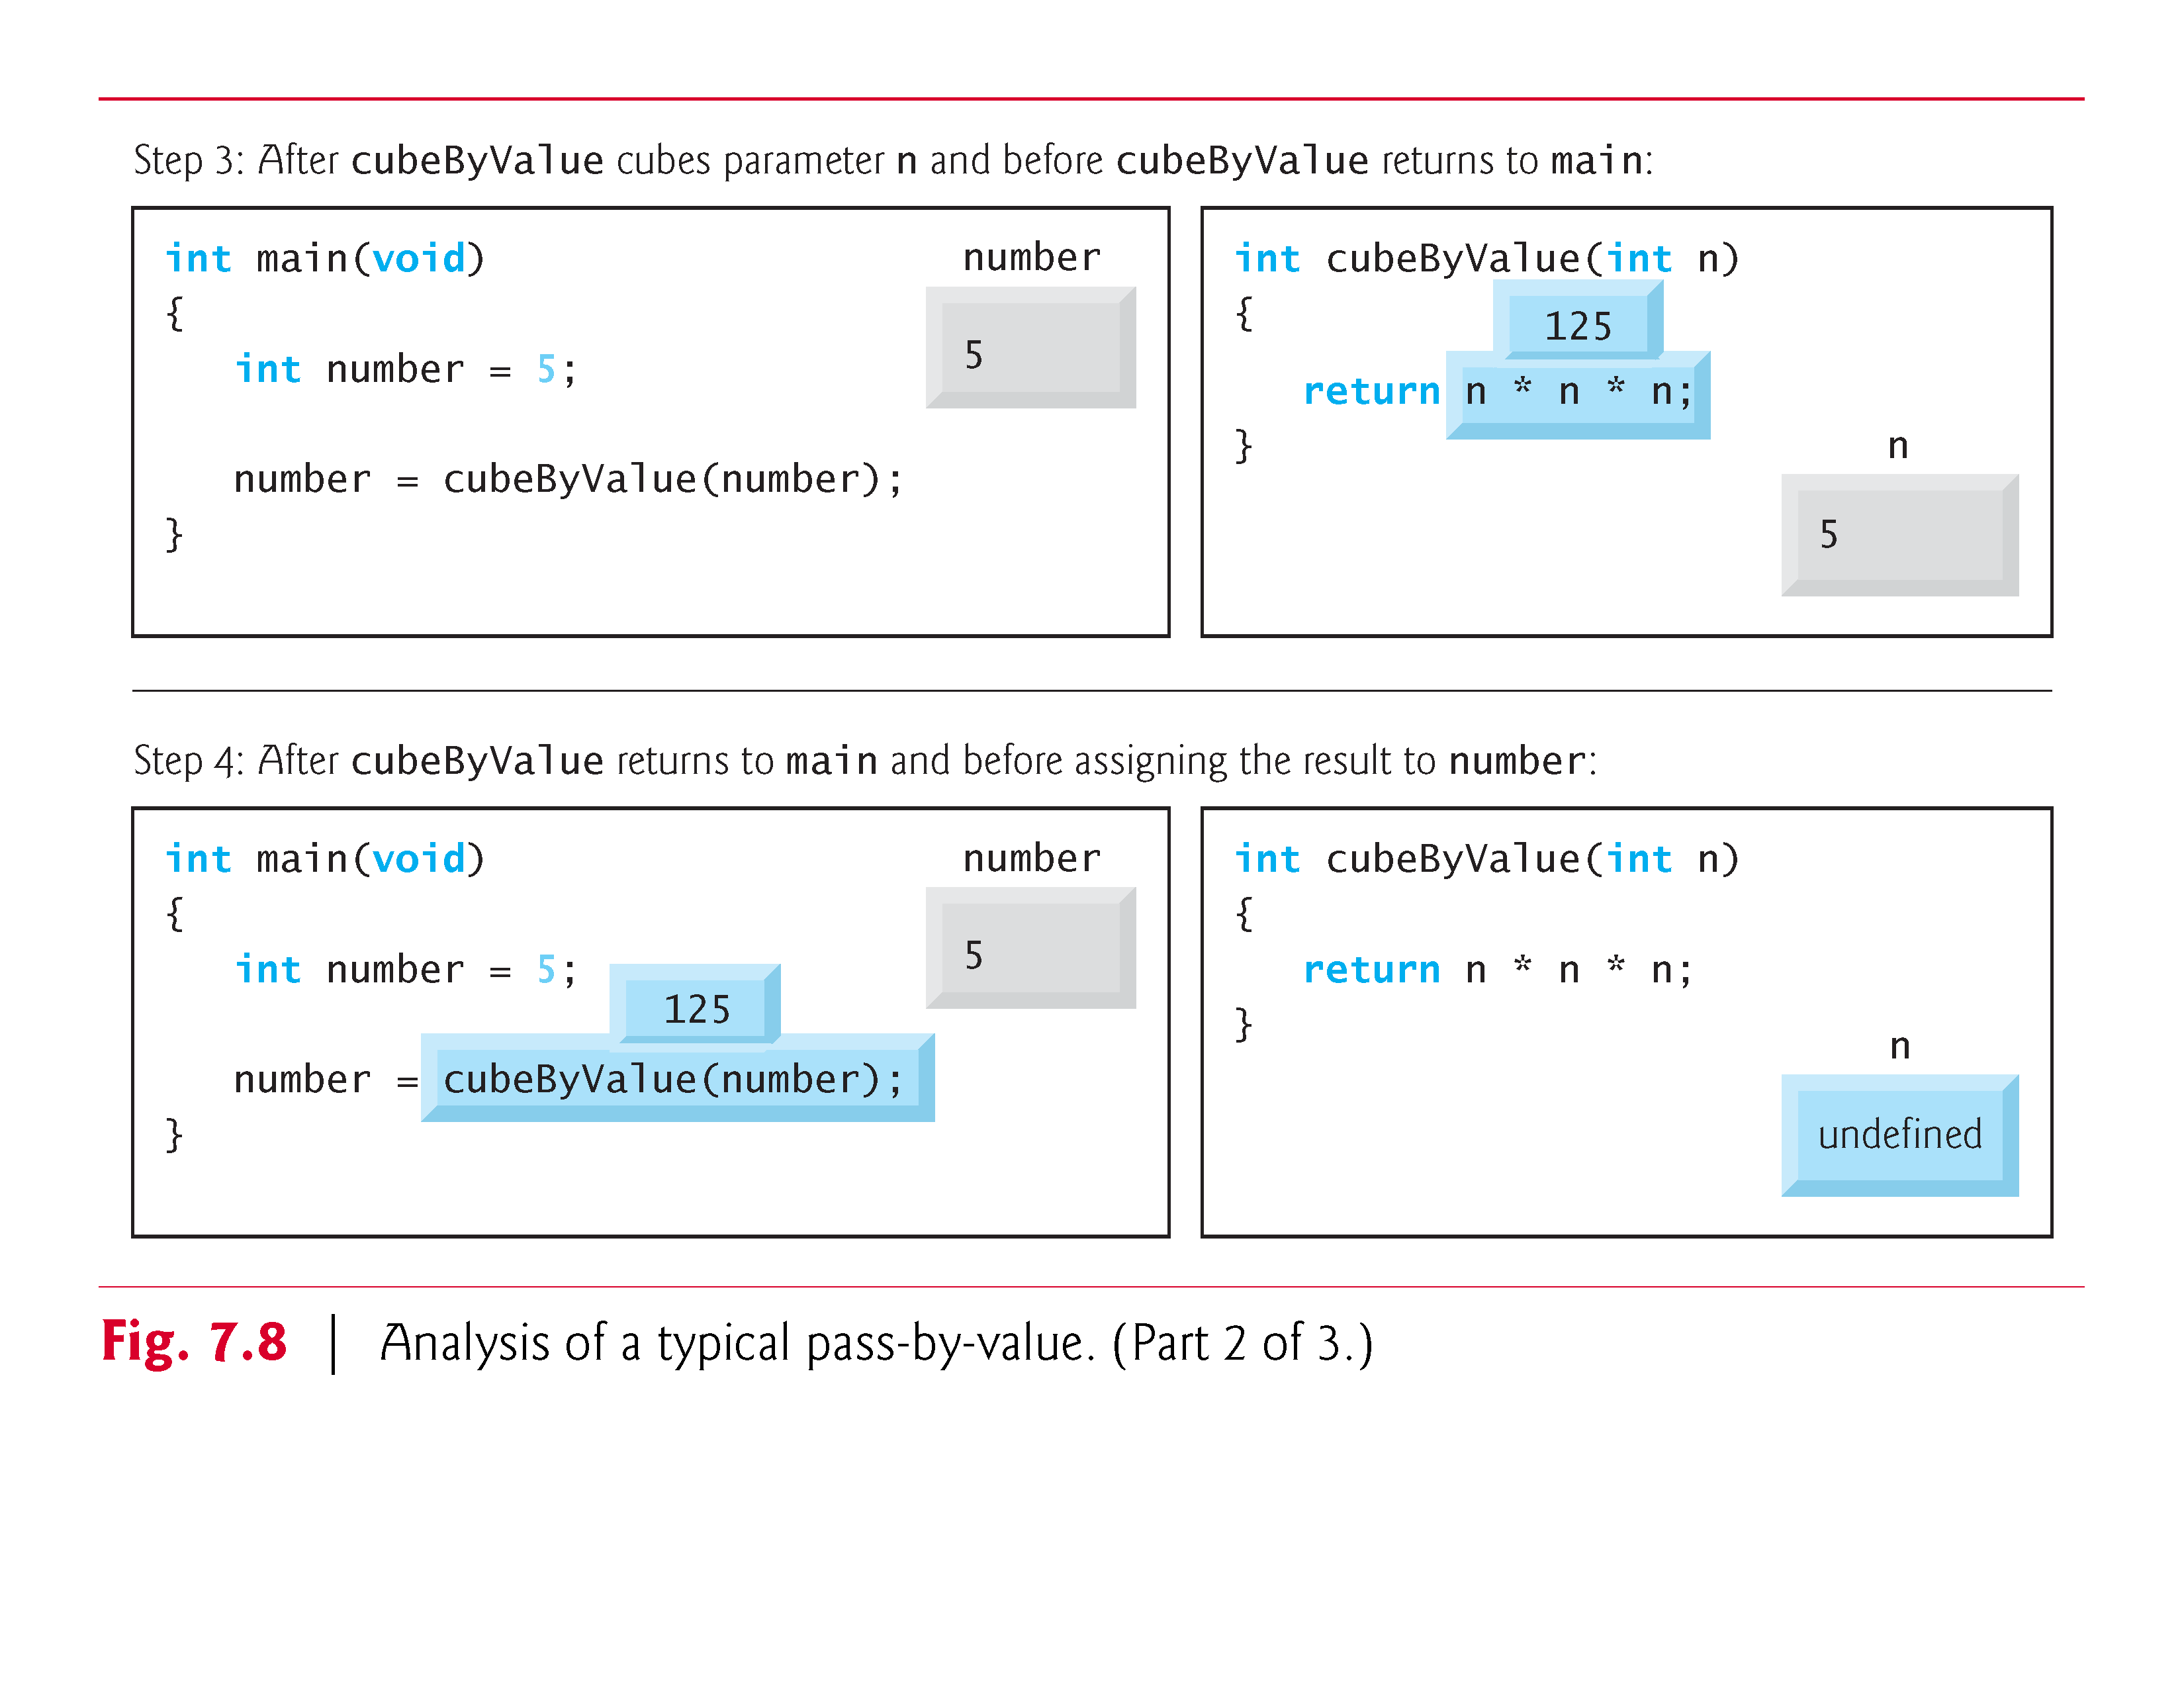

Slide 17
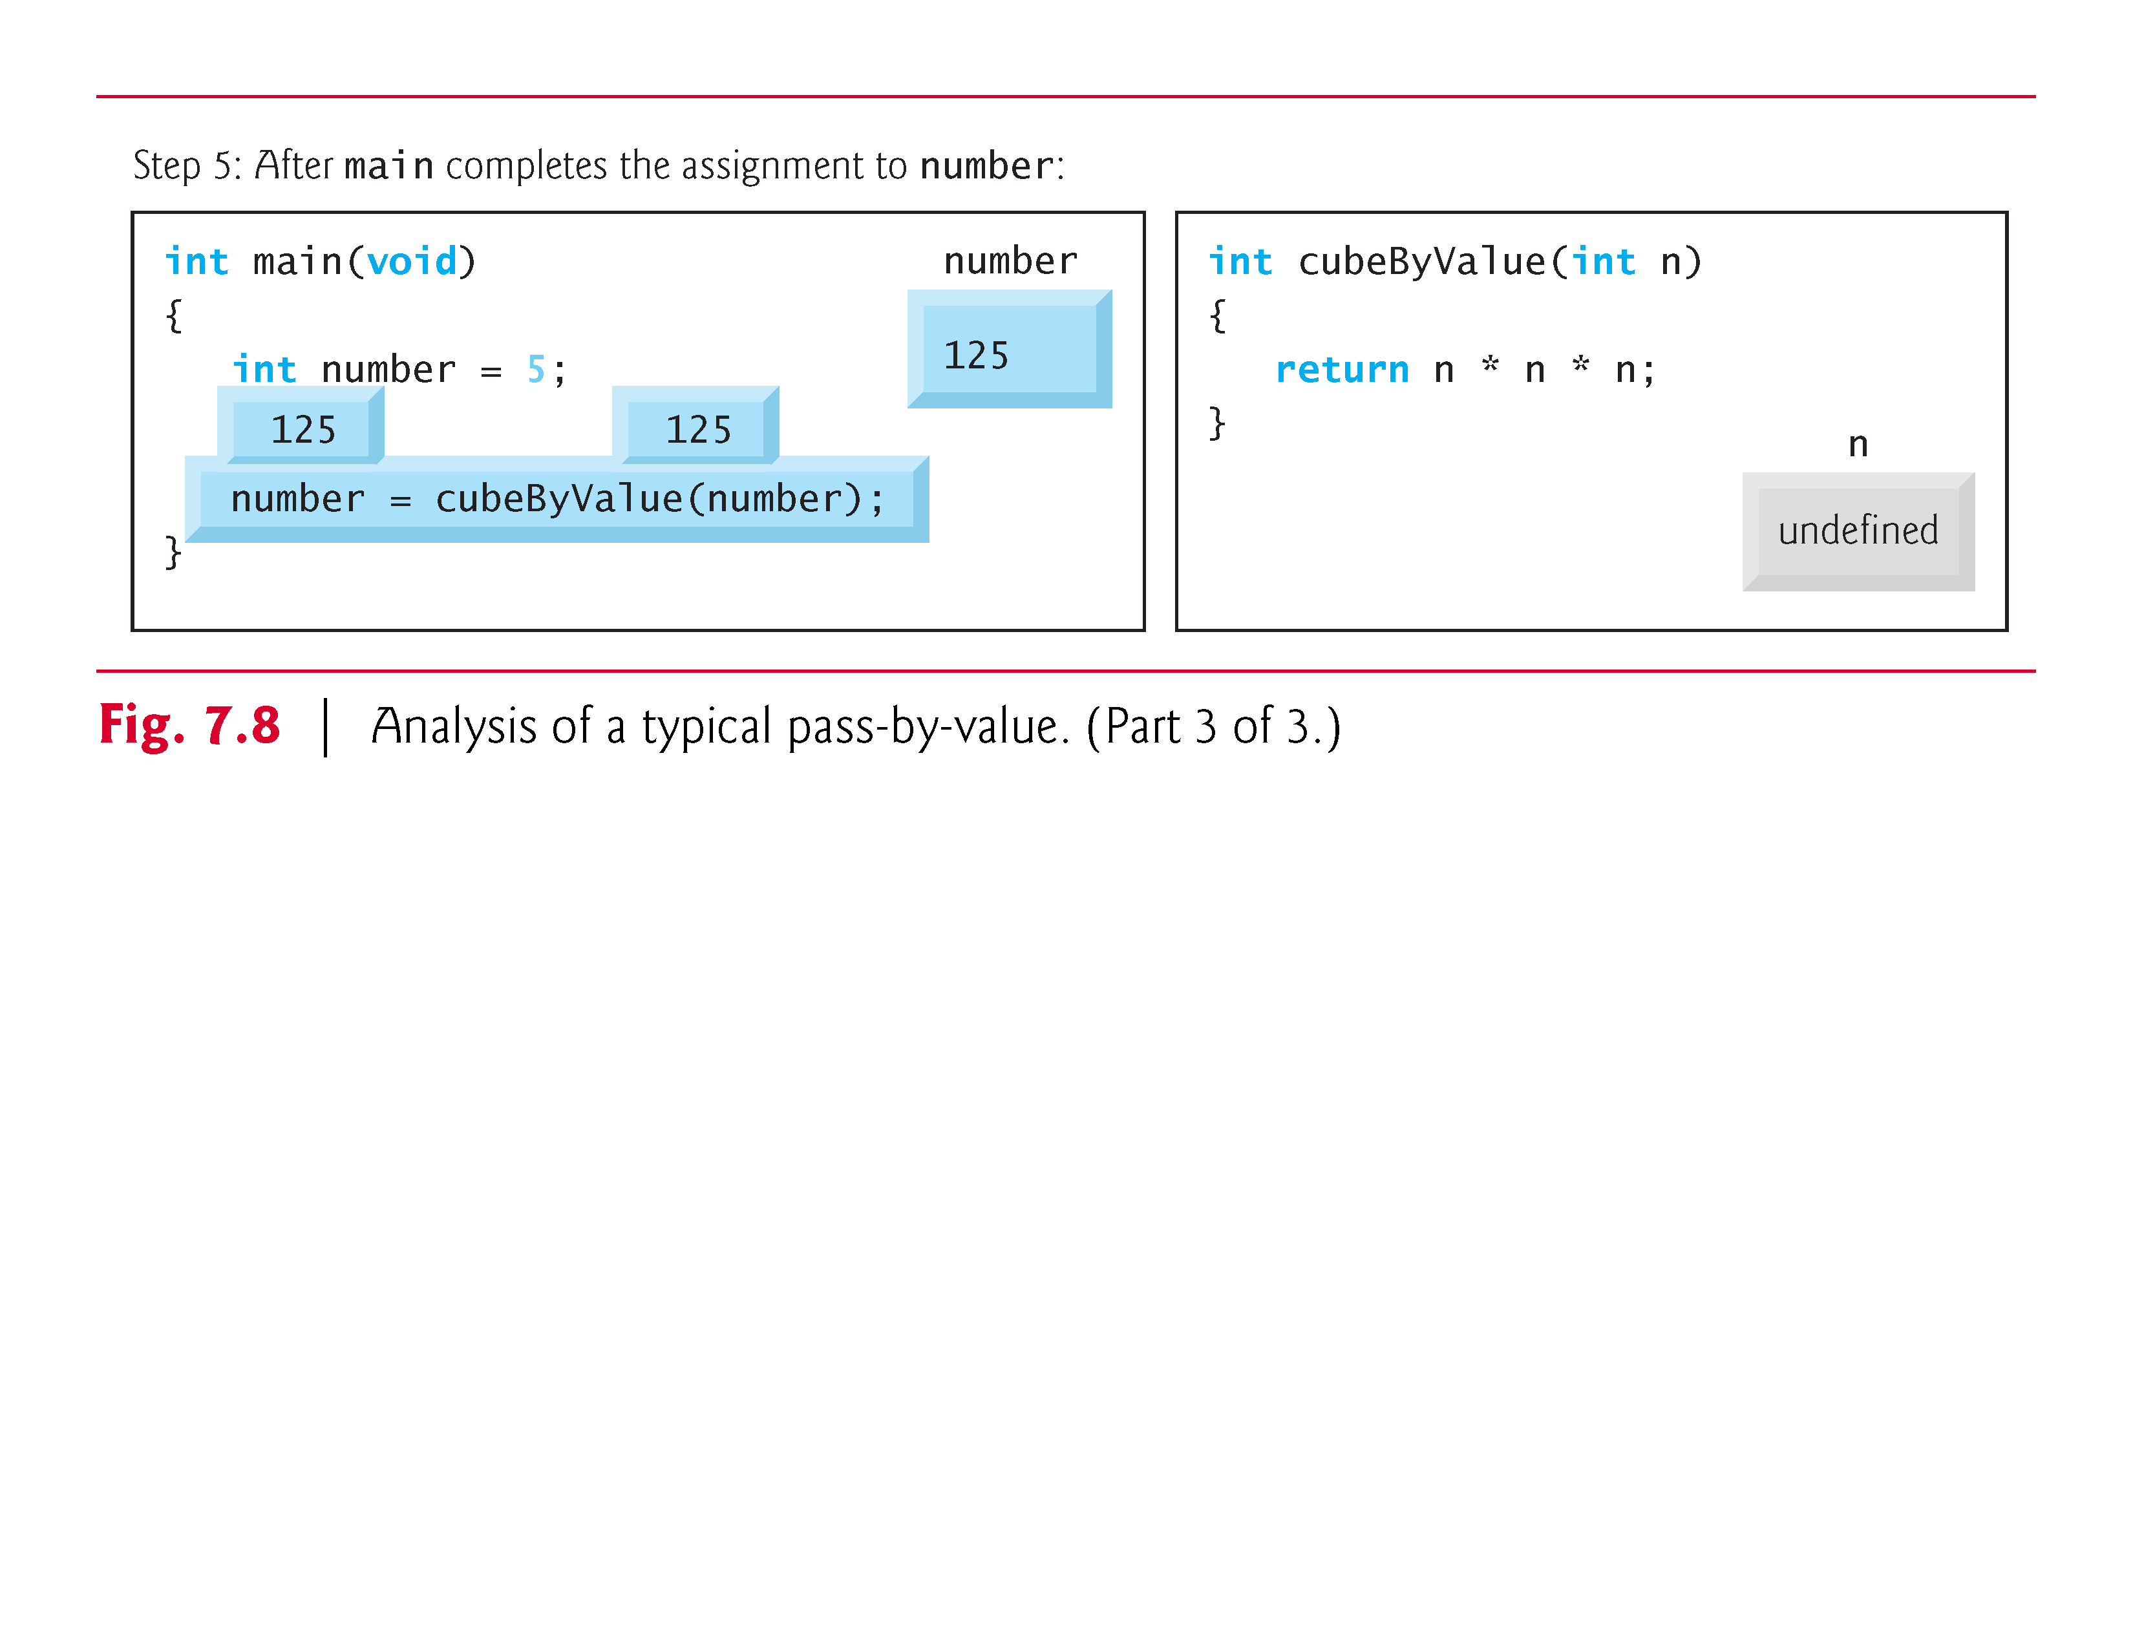

Slide 18
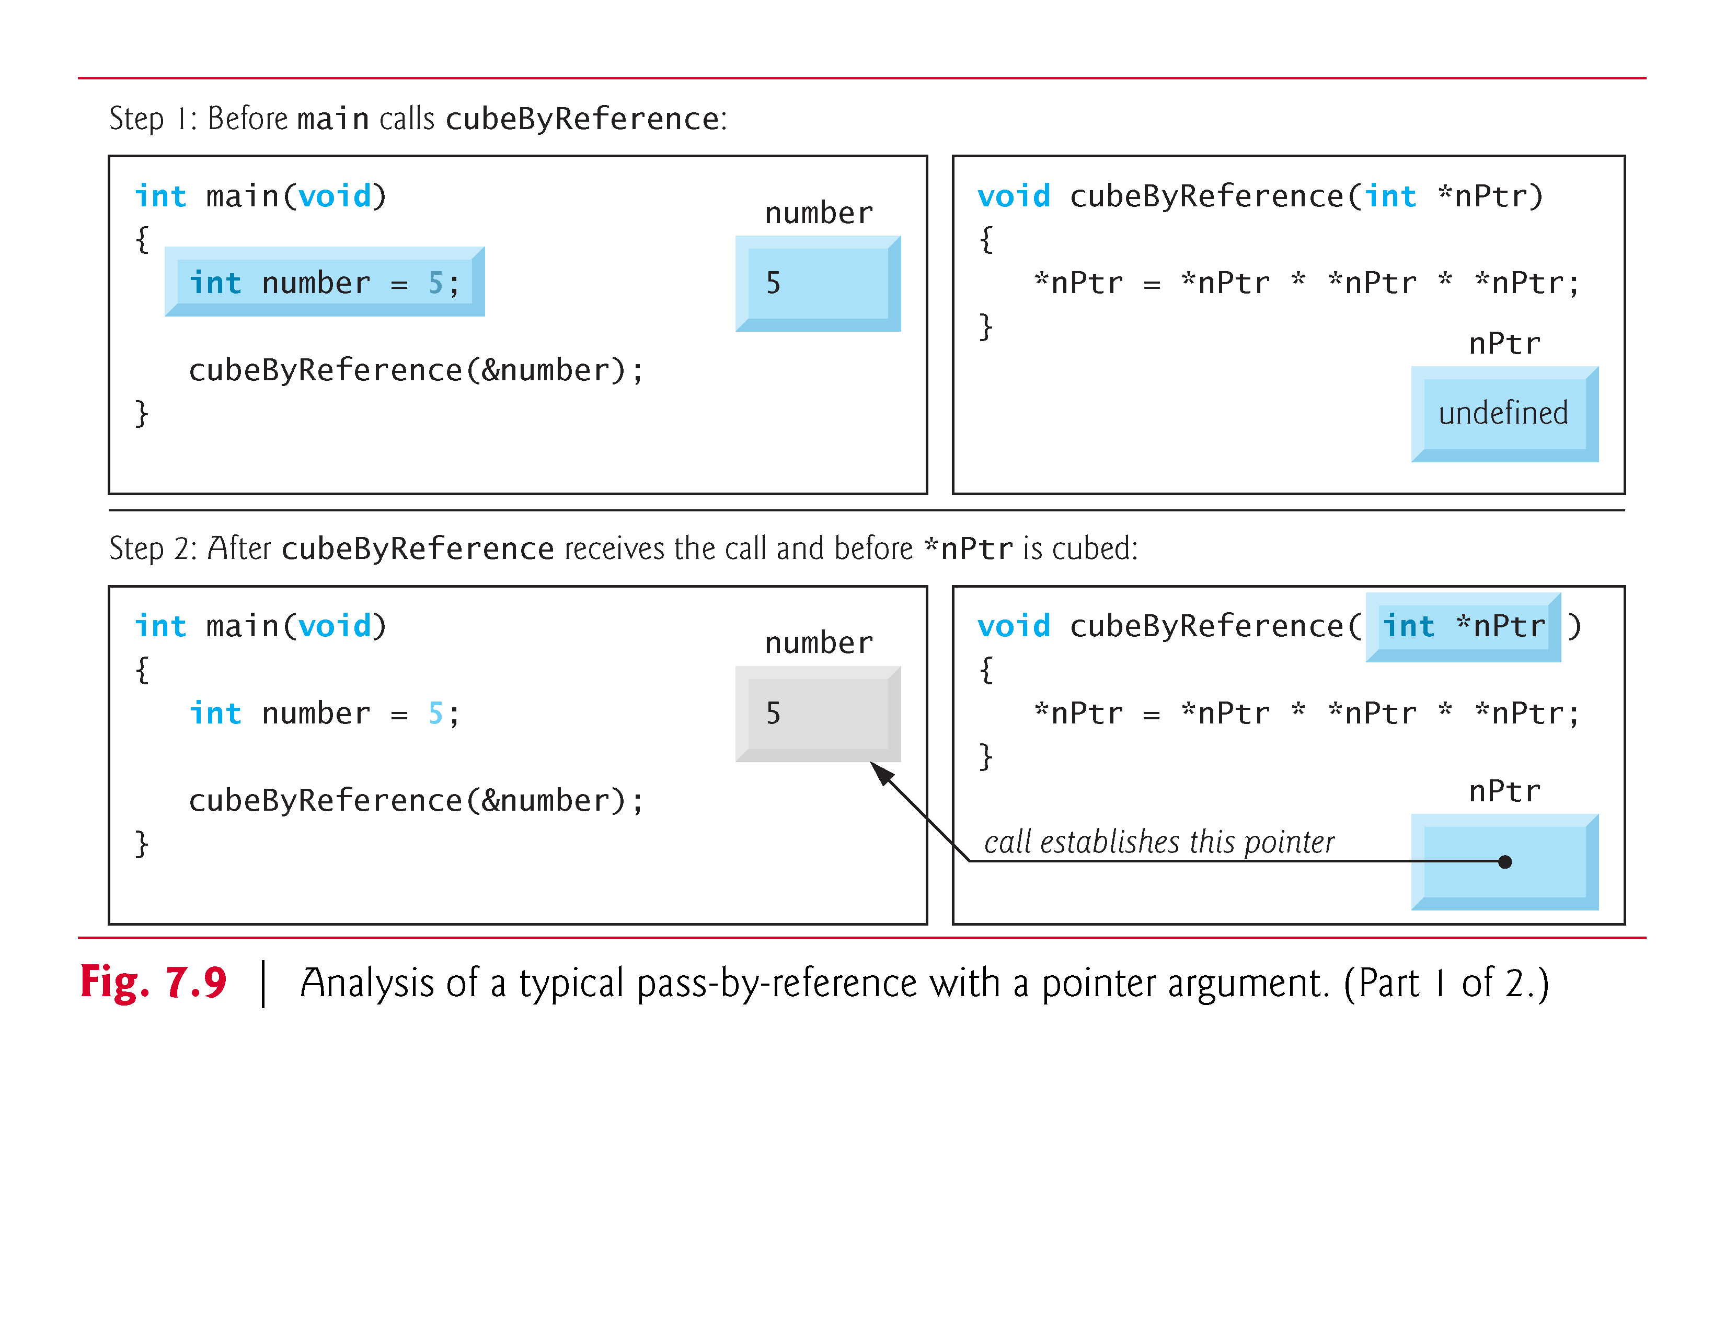

Slide 19
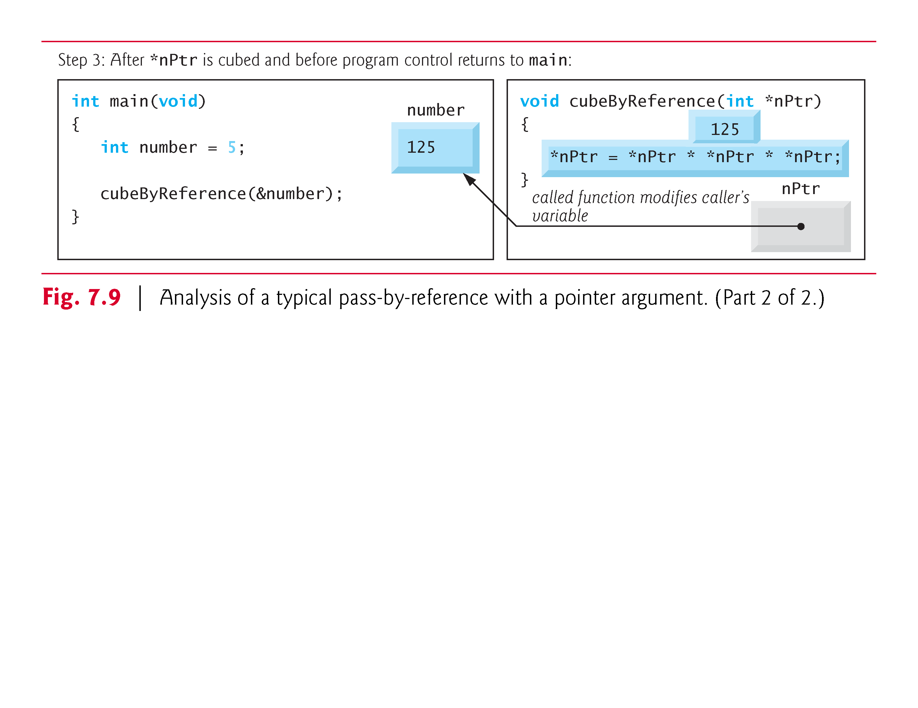

Slide 20
Using the const Qualifier with Pointers
const qualifier
Variable cannot be changed
Use const if function does not need to change a variable
Attempting to change a const variable produces an error
const pointers
Point to a constant memory location
Must be initialized when defined
int *const myPtr = &x;
Type int *const – constant pointer to an int
const int *myPtr = &x;
Regular pointer to a const int
const int *const Ptr = &x;
const pointer to a const int
x can be changed, but not *Ptr

Slide 21
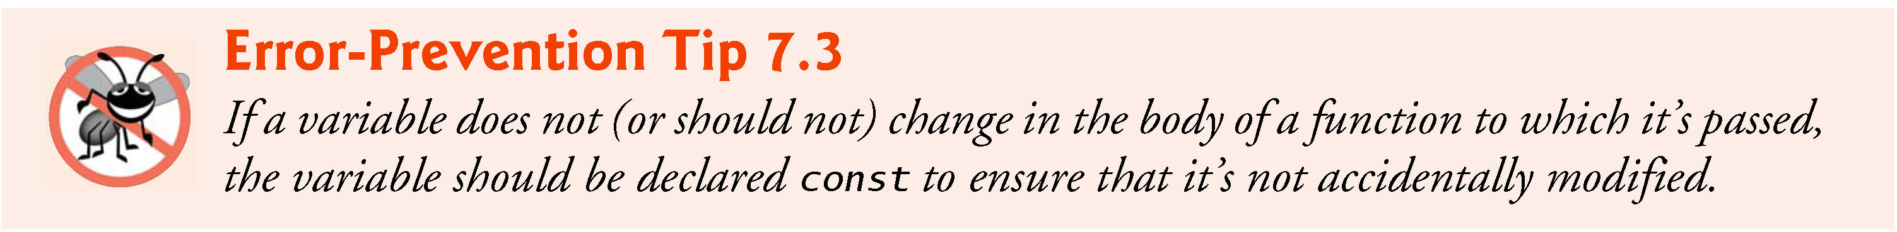
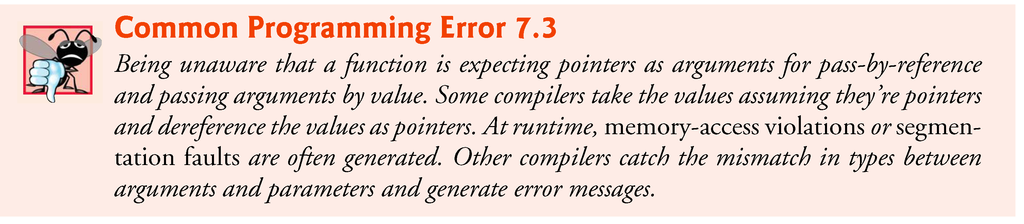

Slide 22
four ways to pass a pointer to a function
a non-constant pointer to non-constant data
It is the highest level of data access
the data can be modified through the dereferenced pointer, and the pointer can be modified to point to other data items.
A declaration for a non-constant pointer to non-constant data does not include const.
a non-constant pointer to constant data
It can be modified to point to any data item of the appropriate type, but the data to which it points cannot be modified.
Such a pointer might be used to receive an array argument to a function that will process each element without modifying the data.
If memory is low and execution efficiency is a concern, use pointers.
If memory is in abundance and efficiency is not a major concern, pass data by value to enforce the principle of least privilege.
Remember that some systems do not enforce const well, so pass-by-value is still the best way to prevent data from being modified.
a constant pointer to nonconstant data
It always points to the same memory location, and the data at that location can be modified through the pointer.
This is the default for an array name.
A constant pointer to non-constant data can be used to receive an array as an argument to a function that accesses array elements using only array index notation
a constant pointer to constant data.
Pointers that are declared const must be initialized when they’re defined (if the pointer is a function parameter, it’s initialized with a pointer that’s passed to the function).
The least access privilege is granted by a constant pointer to constant data.
Such a pointer always points to the same memory location, and the data at that memory location cannot be modified.
This is how an array should be passed to a function that only looks at the array using array index notation and does not modify the array.

Slide 23
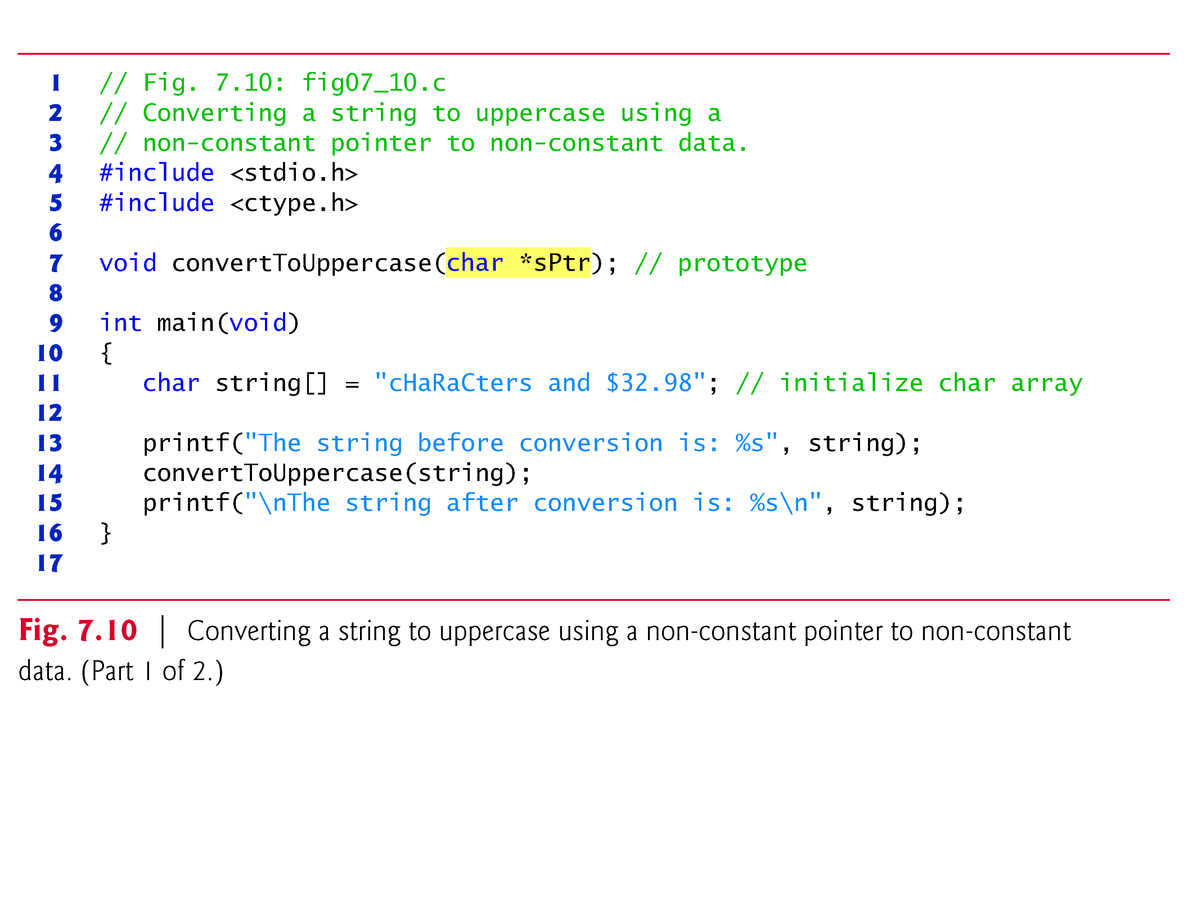
1

Slide 24
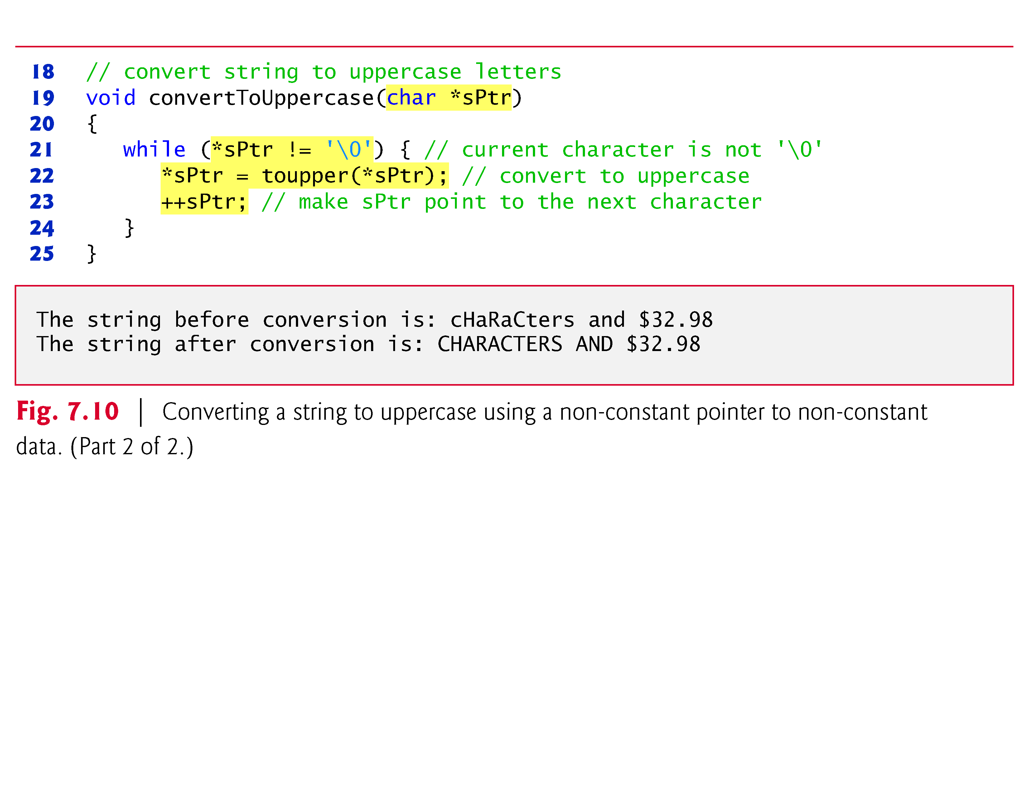

Slide 25
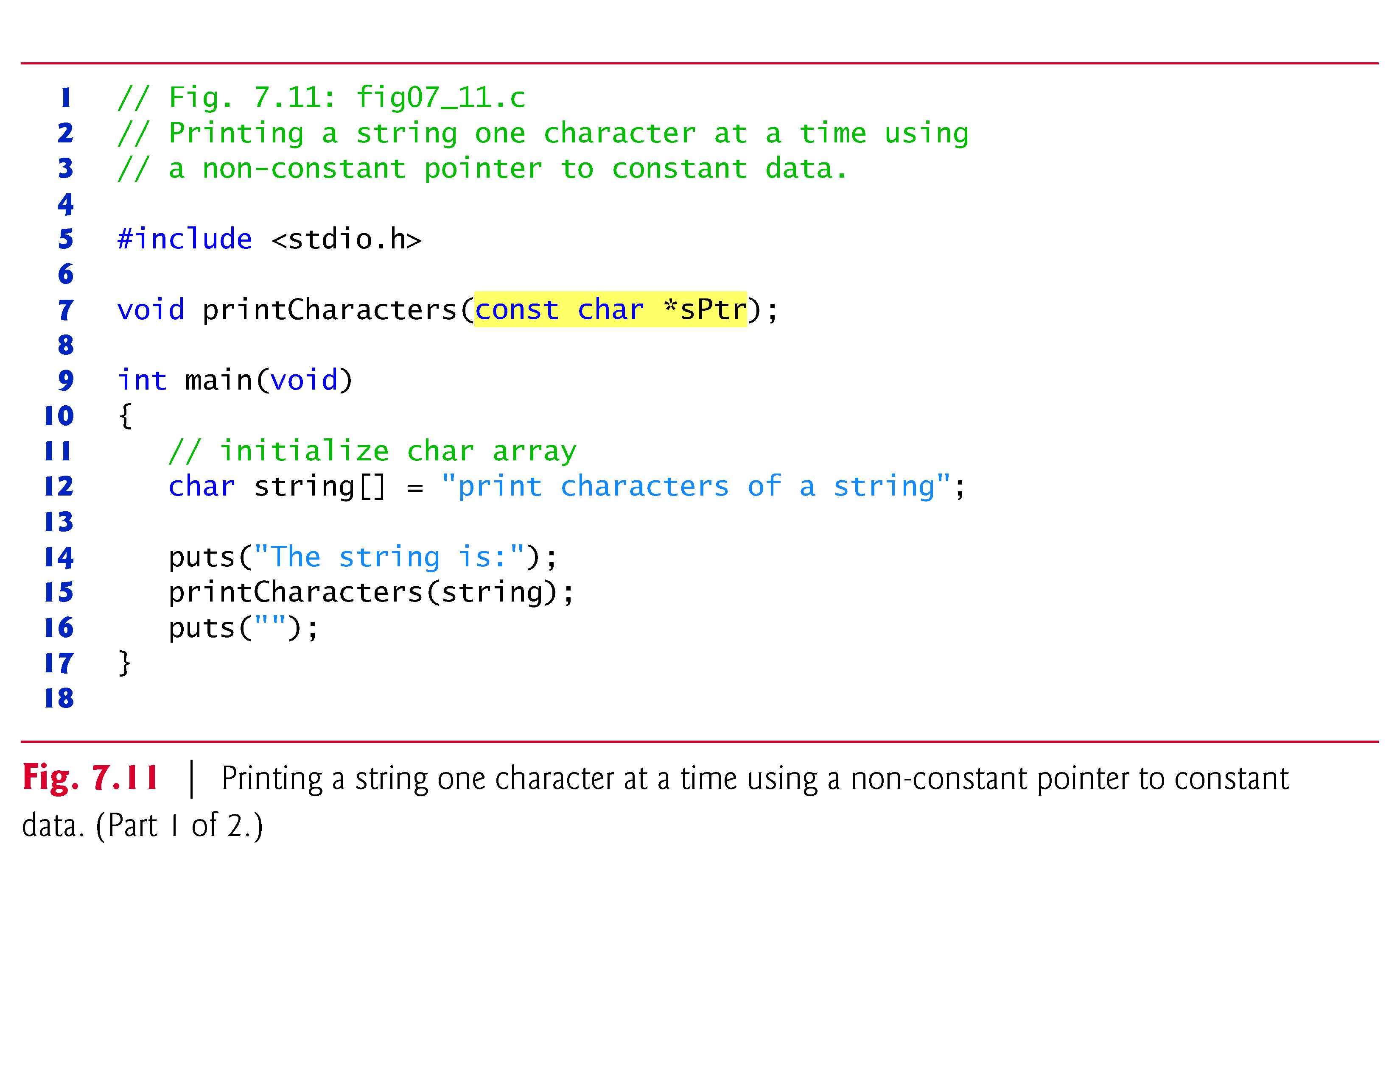
2

Slide 26
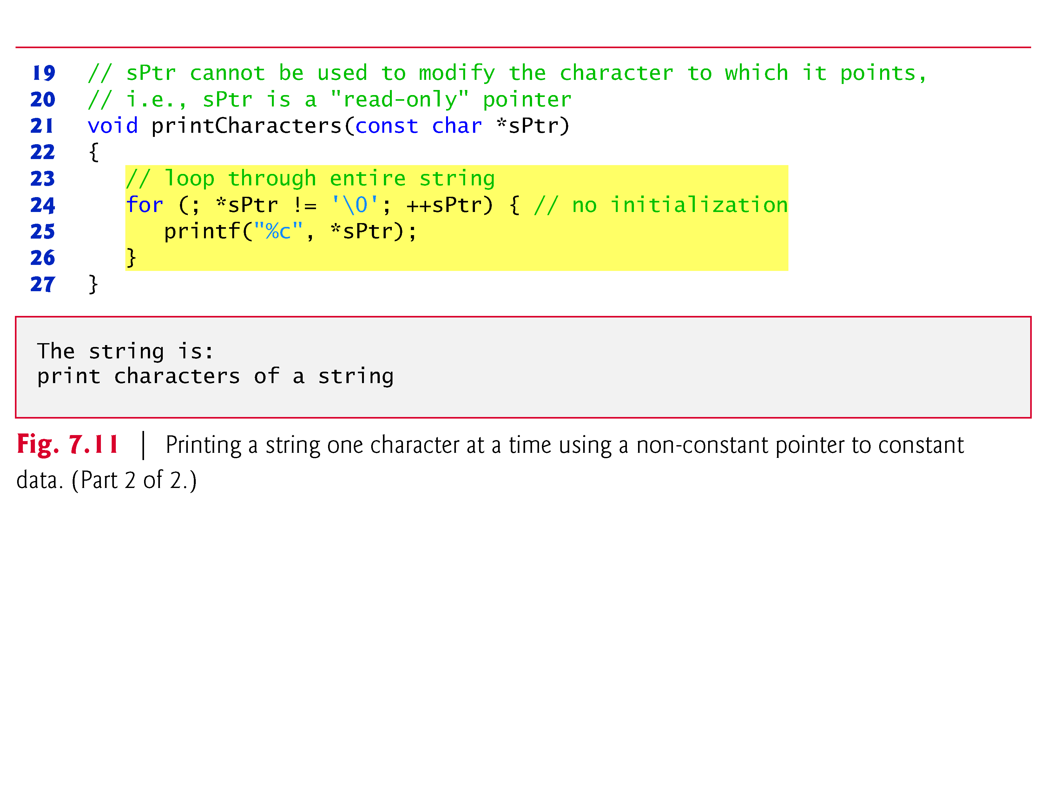

Slide 27
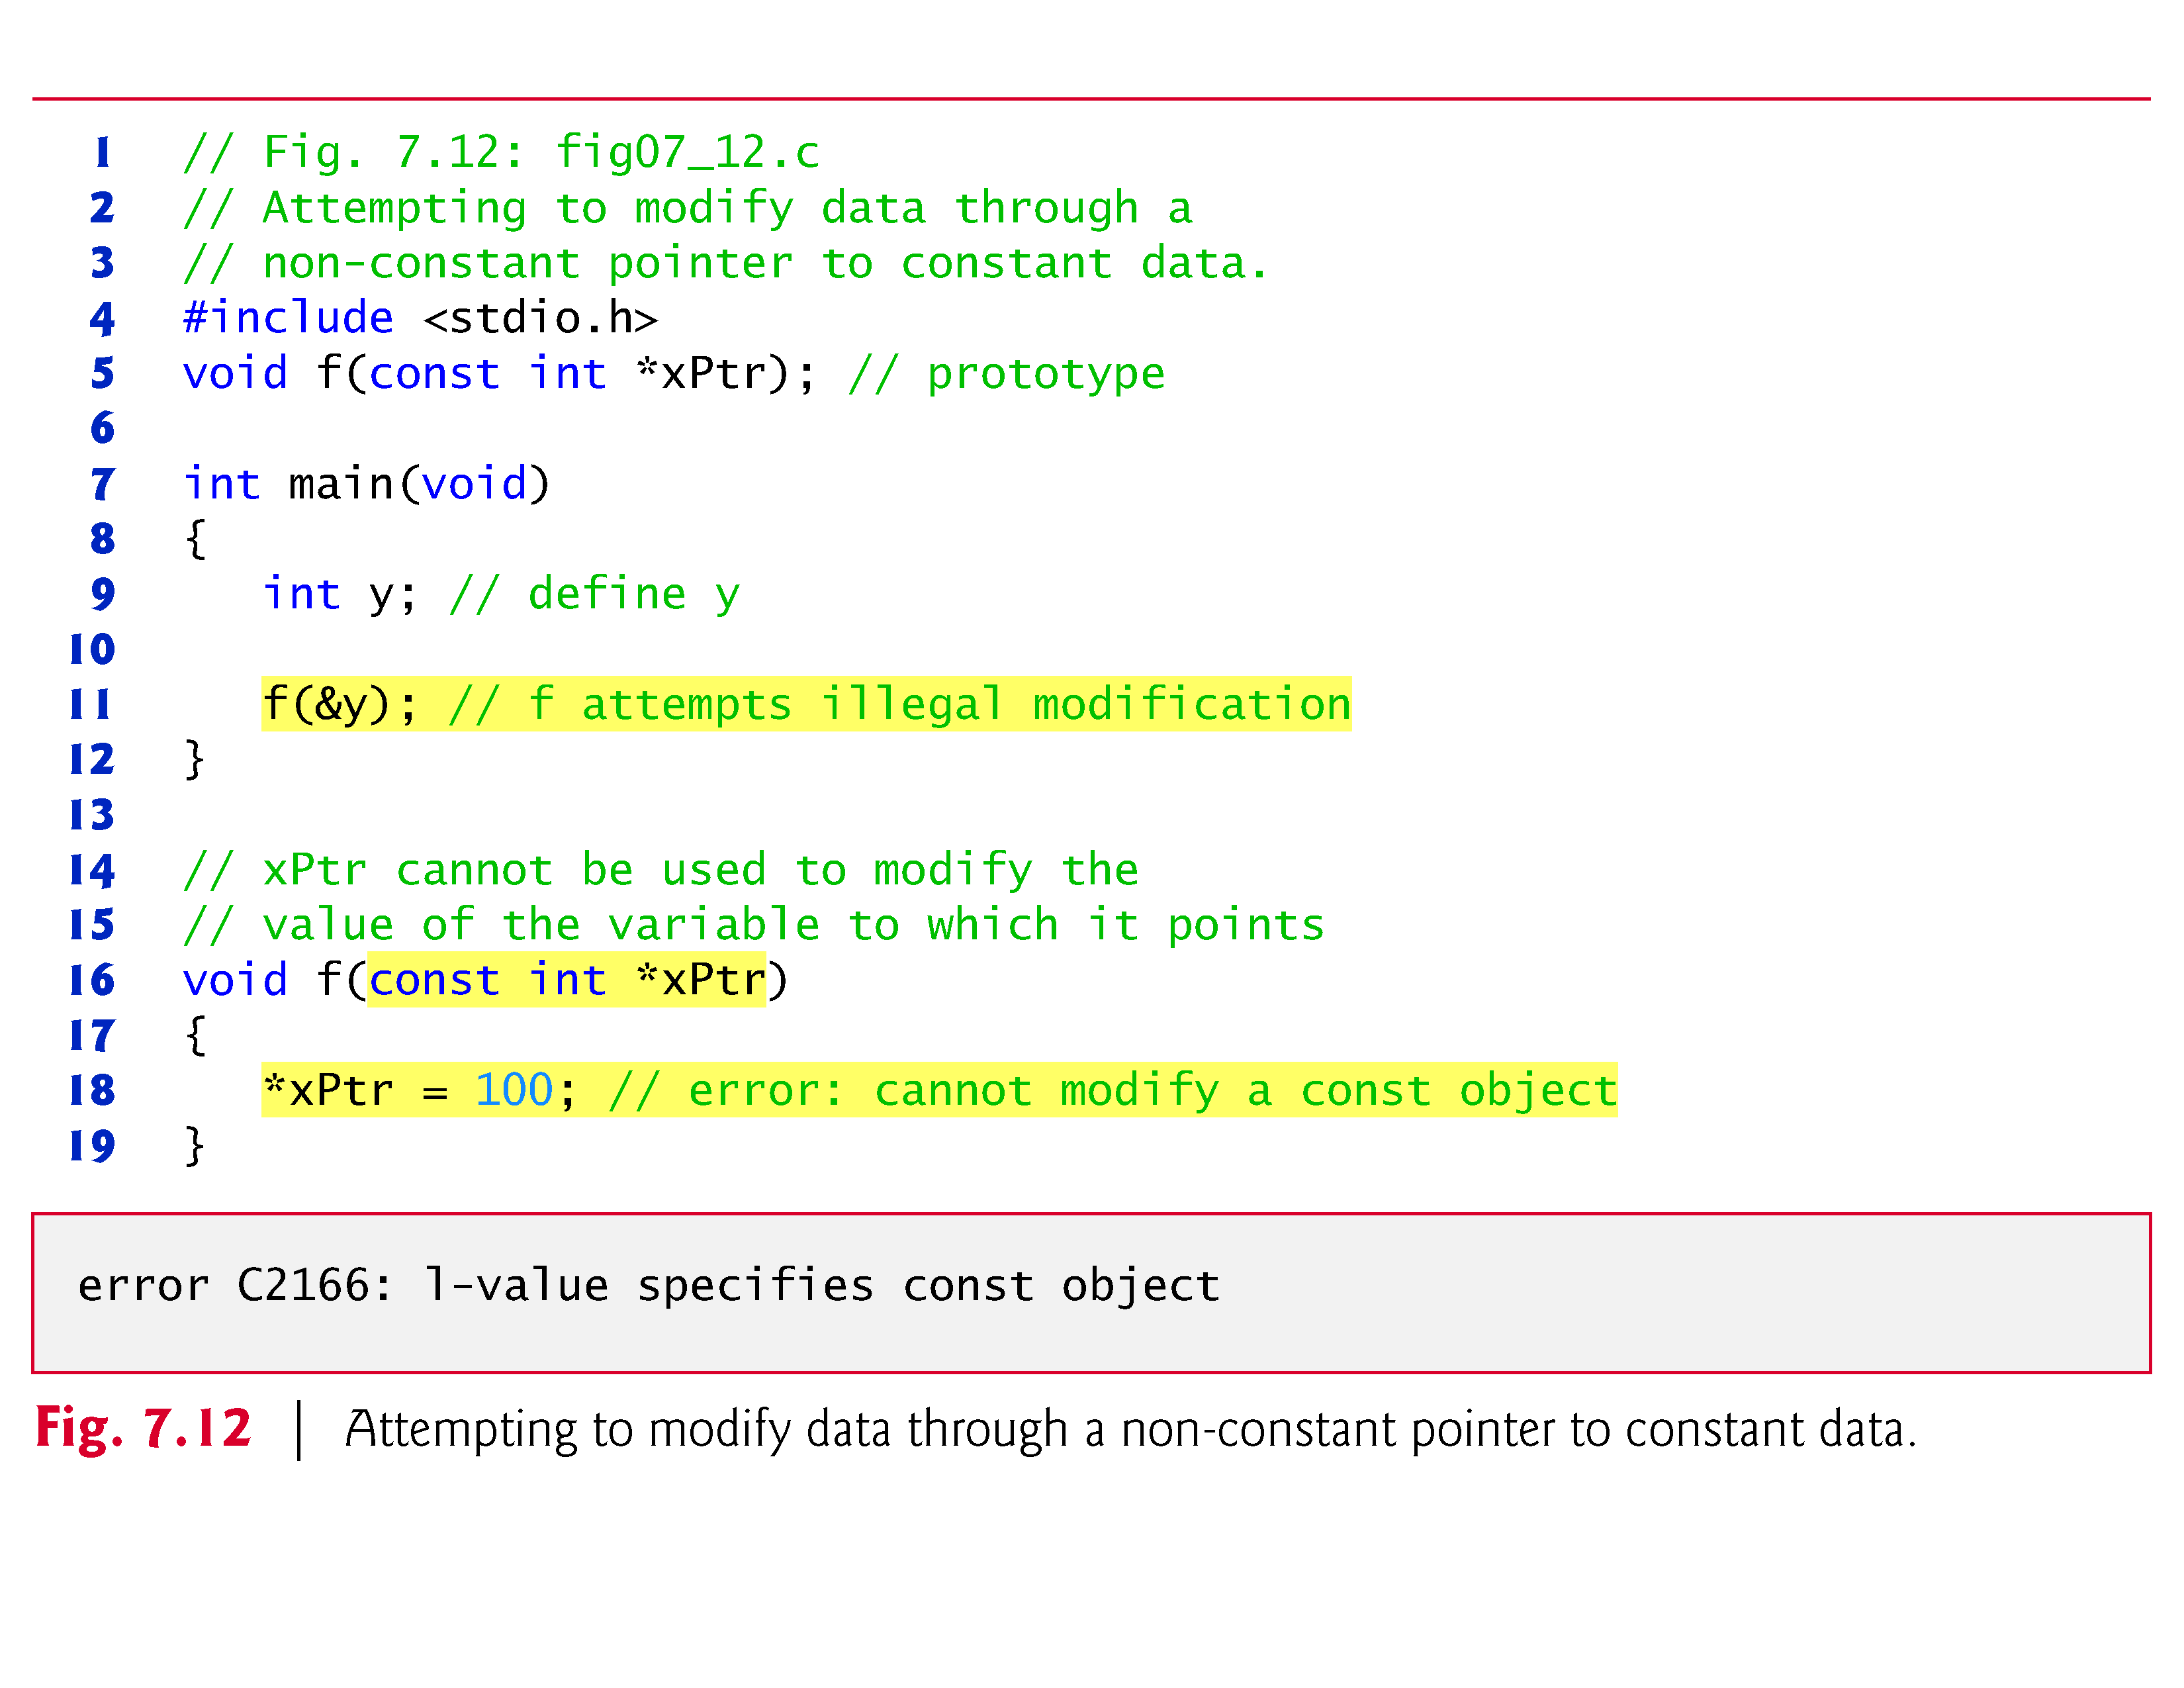

Slide 28
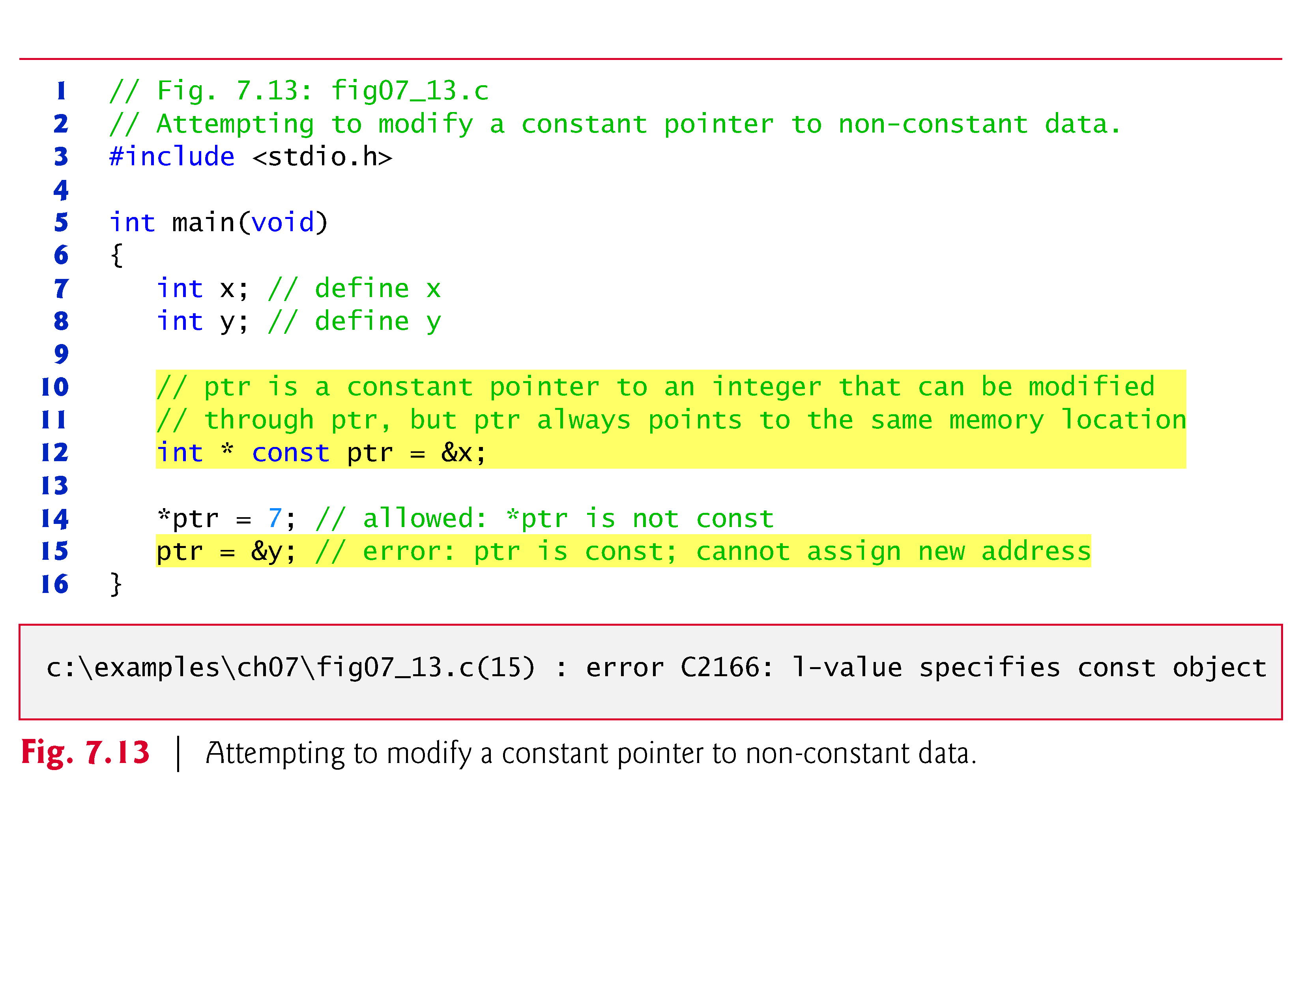
3

Slide 29
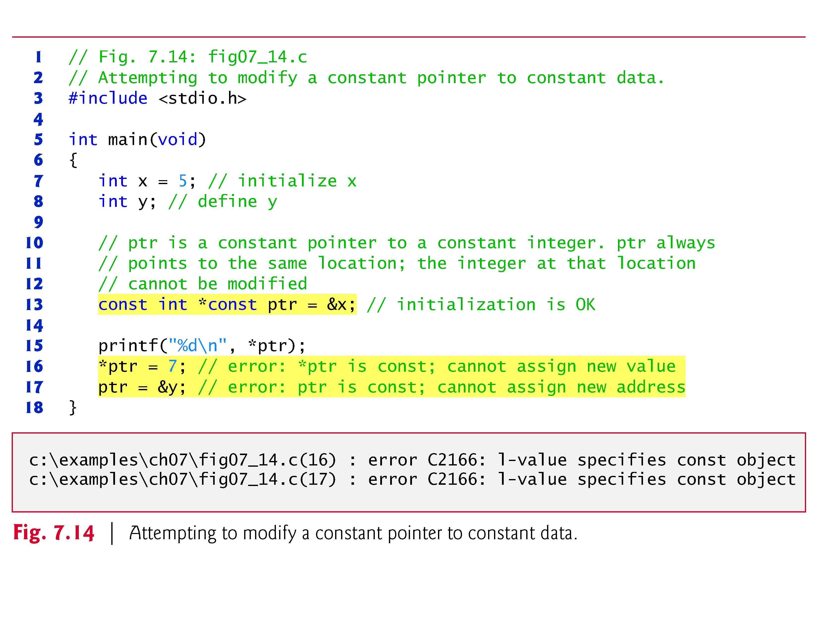
4

Slide 30
Bubble Sort Using Call-by-reference
Implement bubblesort using pointers
Swap two elements
swap function must receive address (using &) of array elements
Array elements have call-by-value default
Using pointers and the * operator, swap can switch array elements
Psuedocode
Initialize array
print data in original order
Call function bubblesort
print sorted array
Define bubblesort

Slide 31
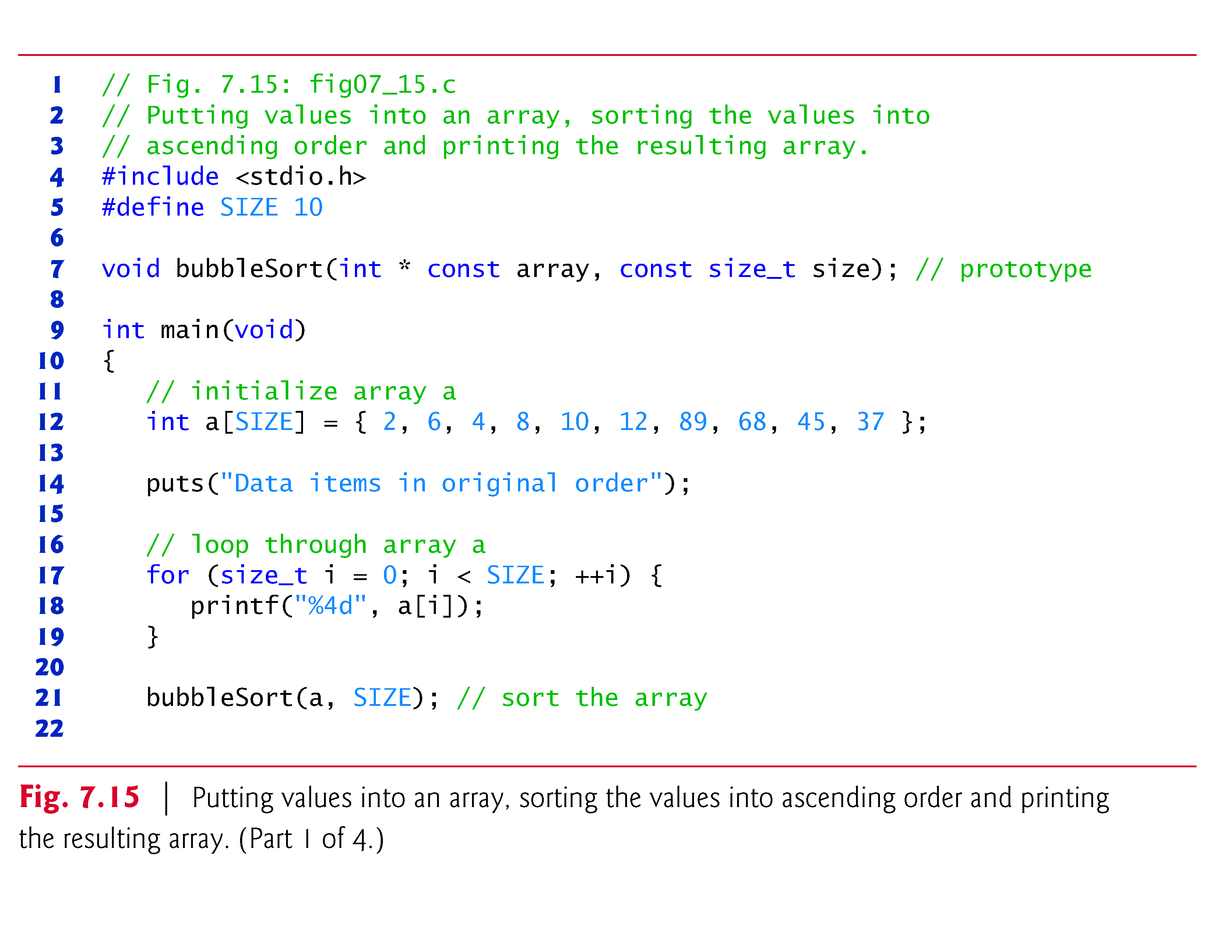

Slide 32
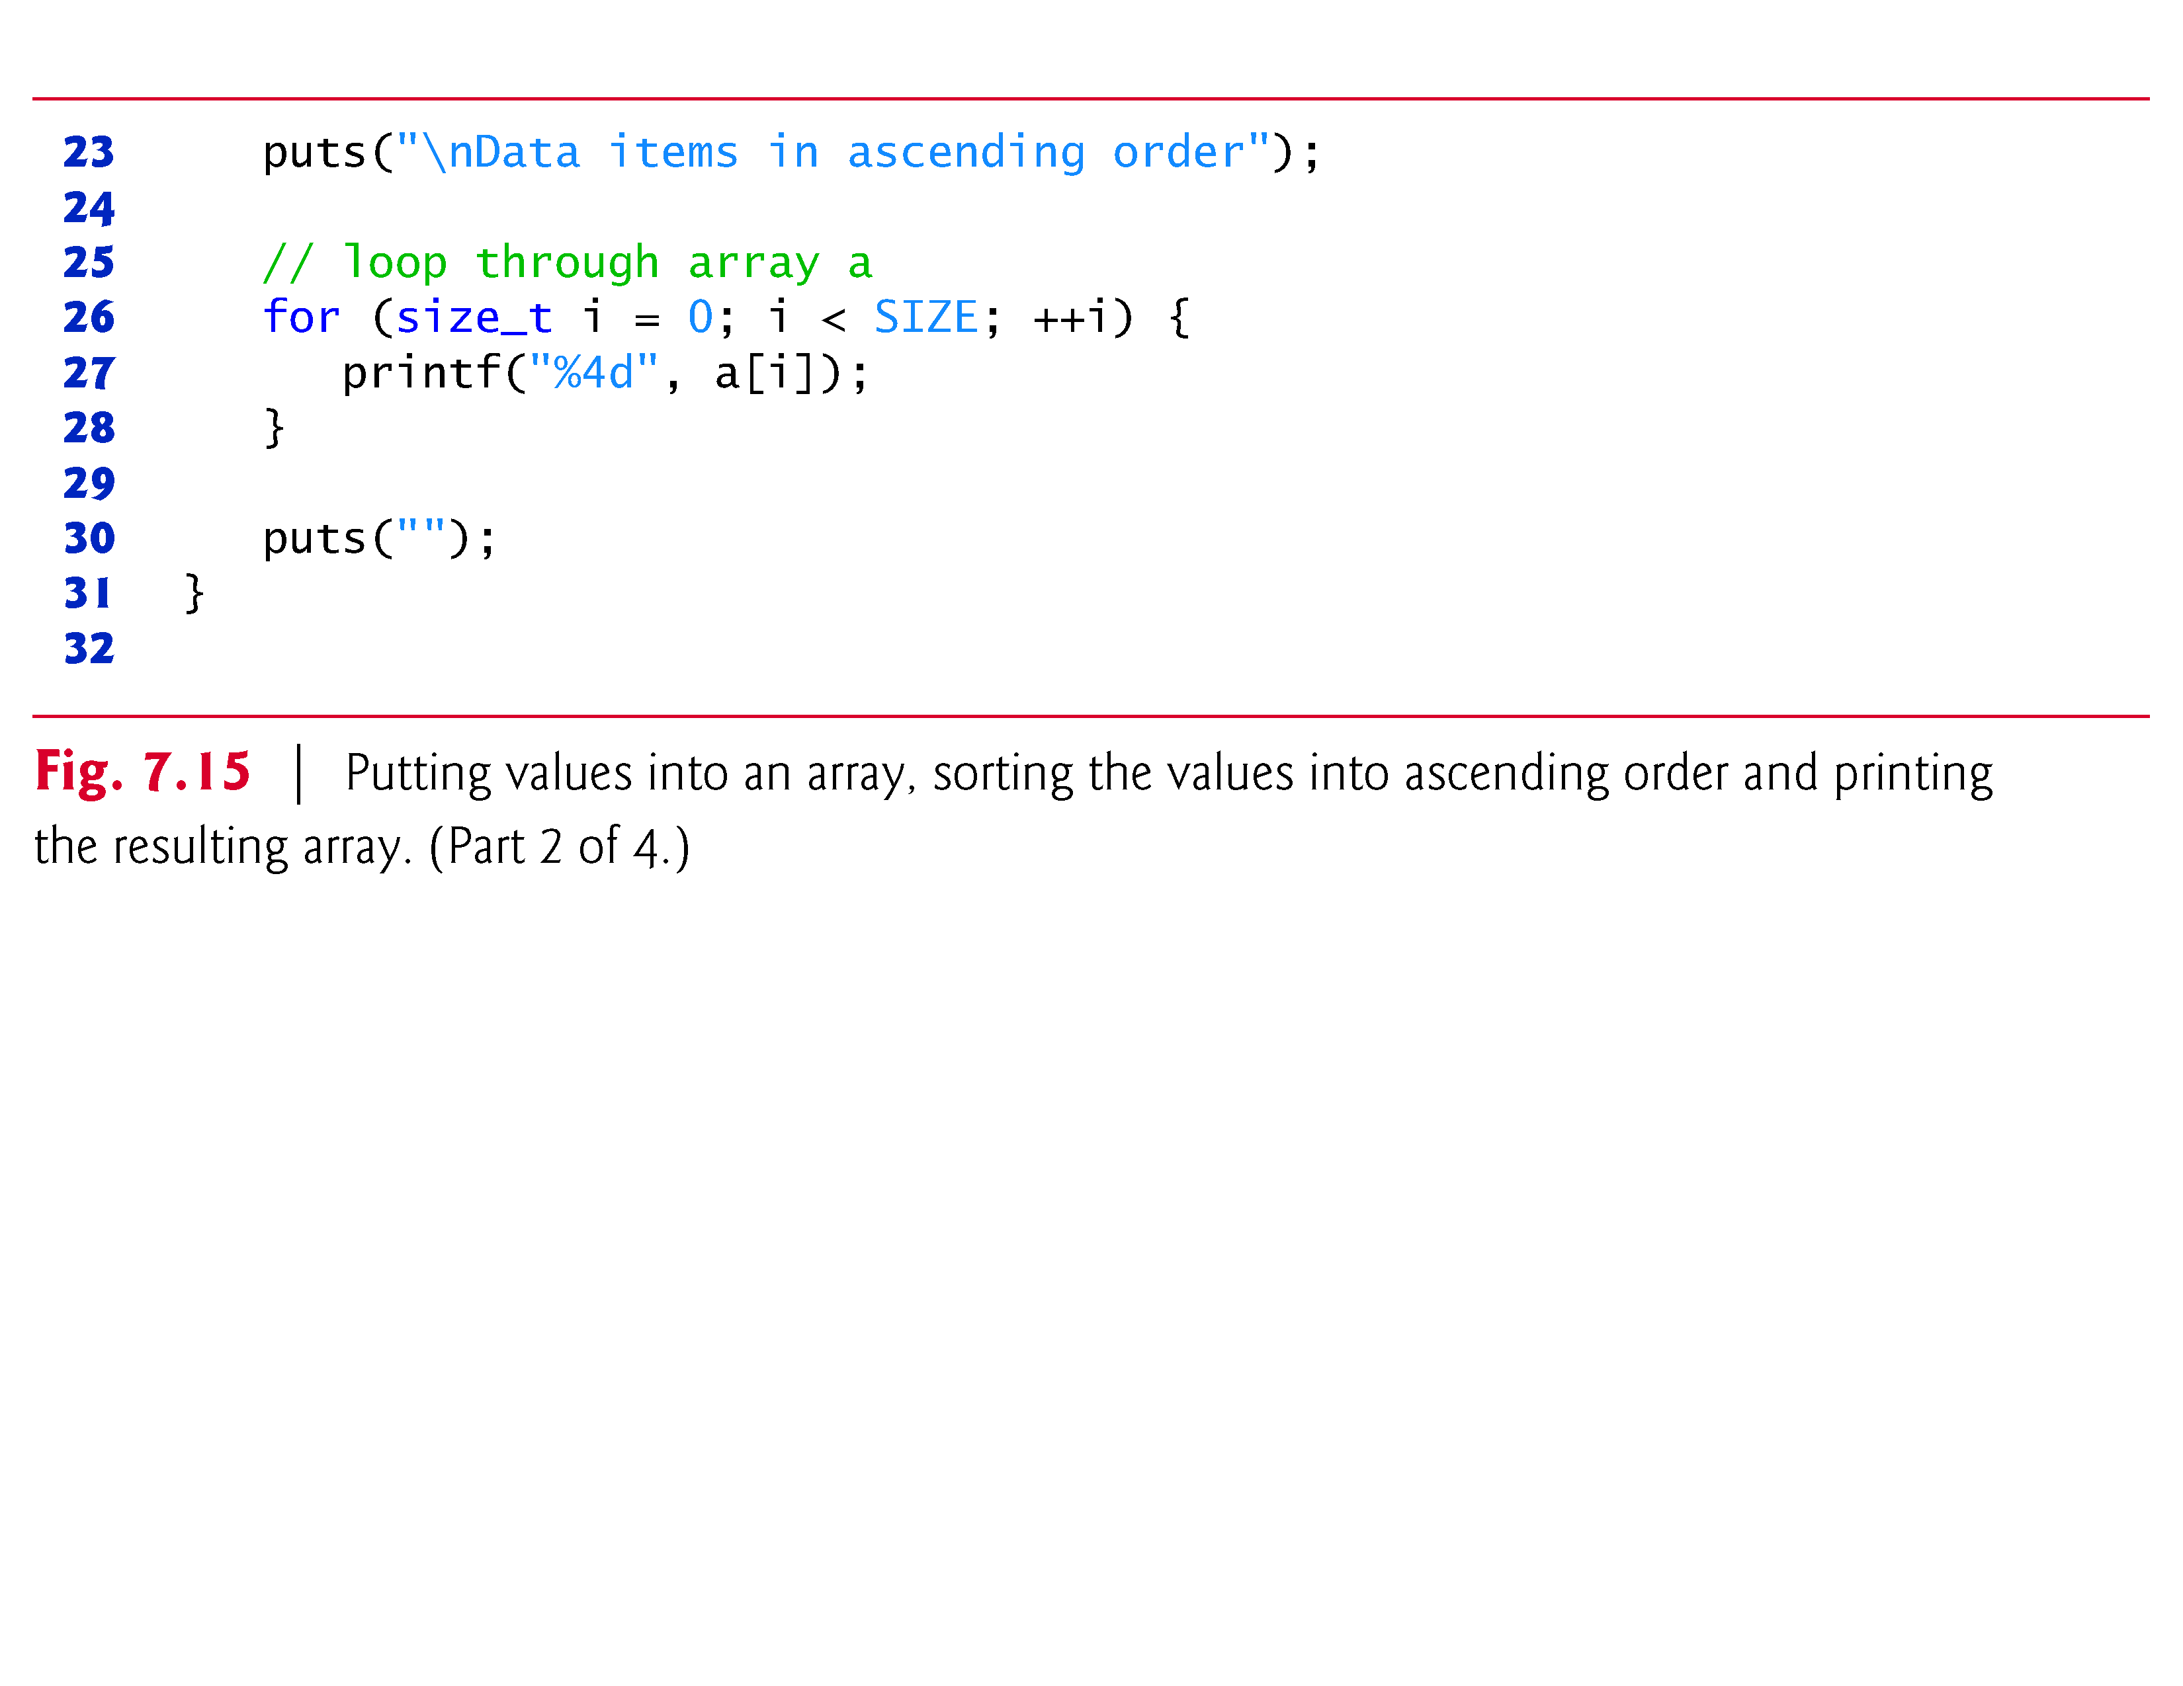

Slide 33
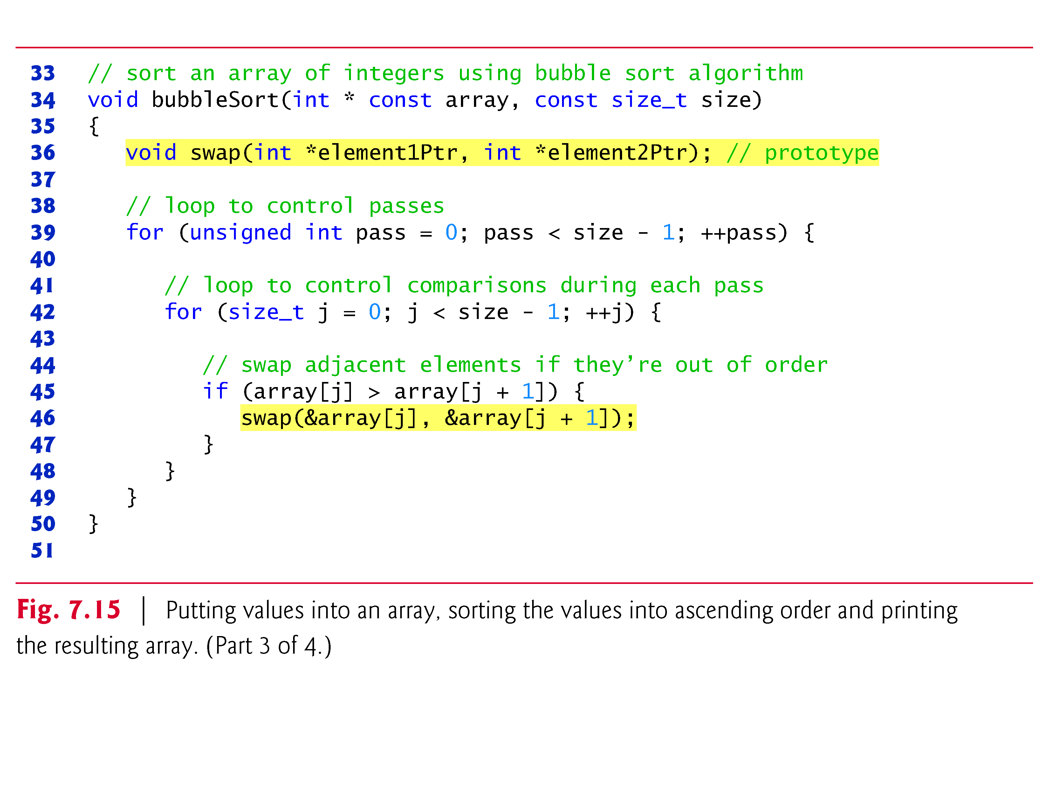

Slide 34
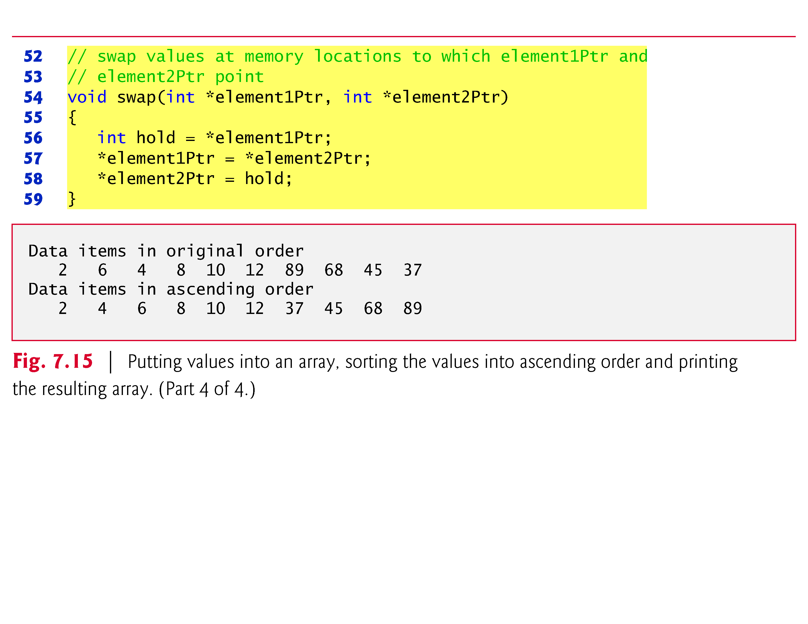

Slide 35
Bubble Sort Using Call-by-reference
sizeof
Returns size of operand in bytes
For arrays: size of 1 element * number of elements
if sizeof( int ) equals 4 bytes, then
int myArray[ 10 ];
printf( "%d", sizeof( myArray ) );
will print 40
sizeof can be used with
Variable names
Type name
Constant values

Slide 36
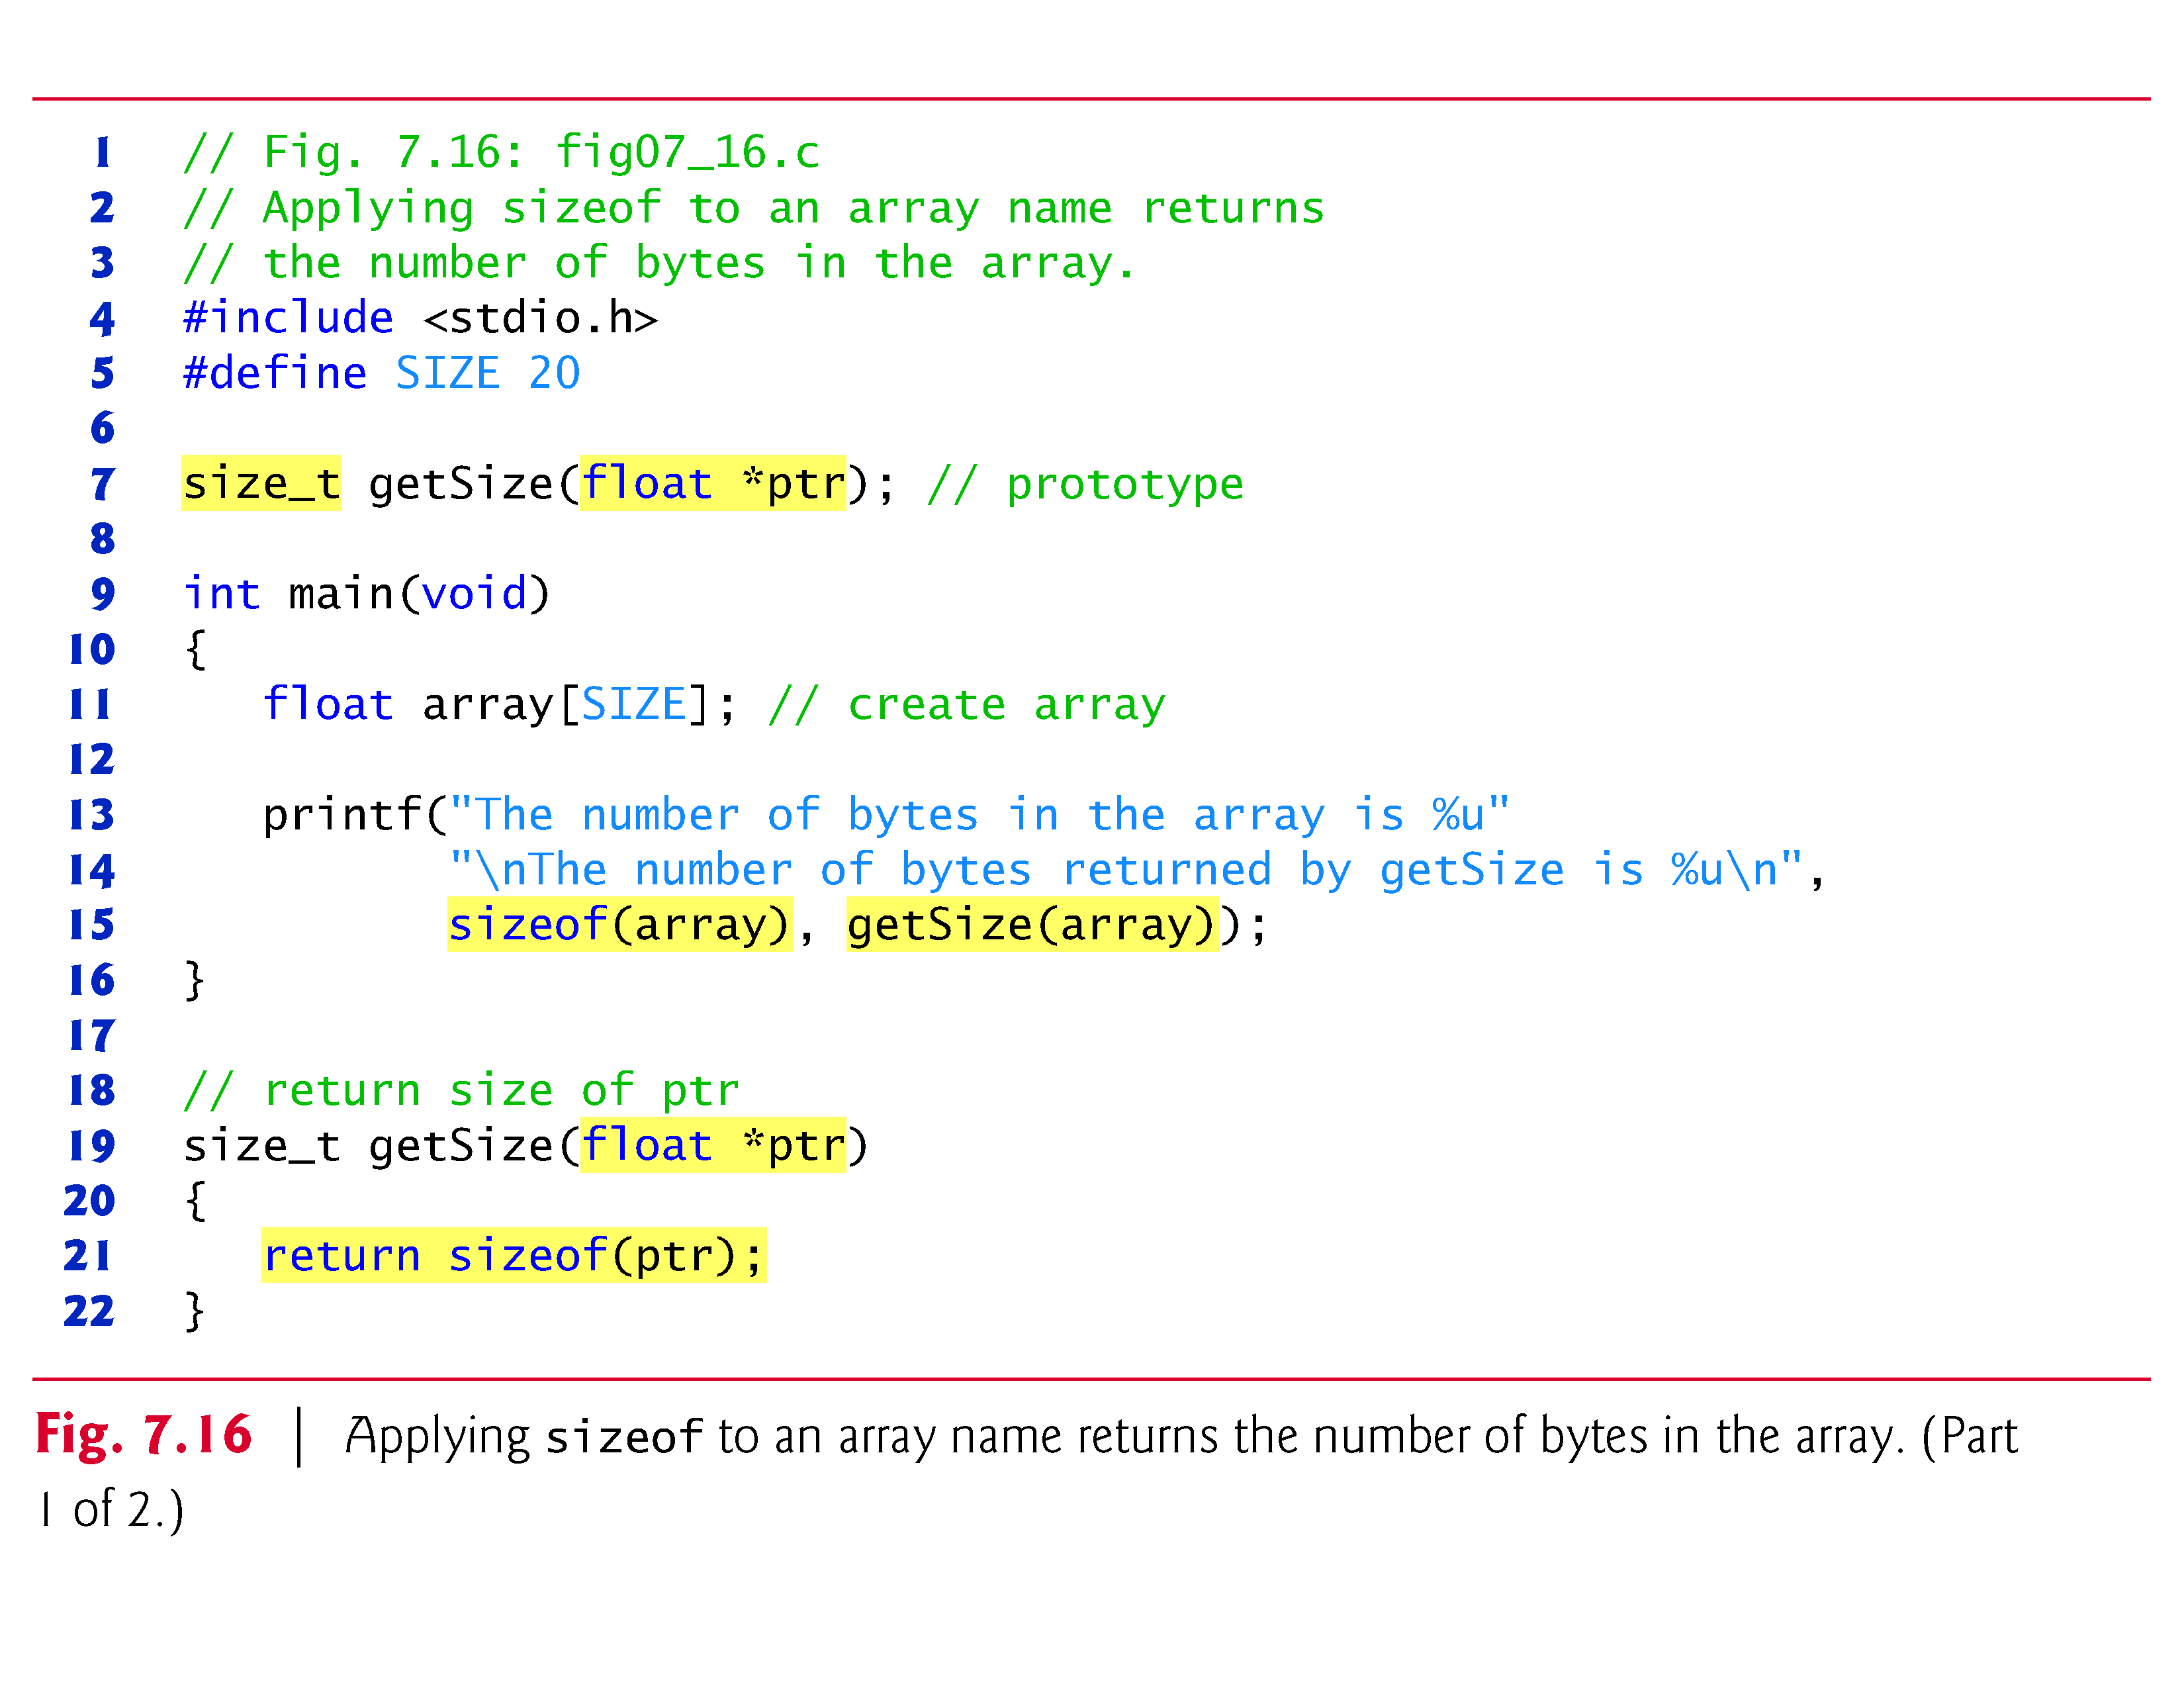

Slide 37
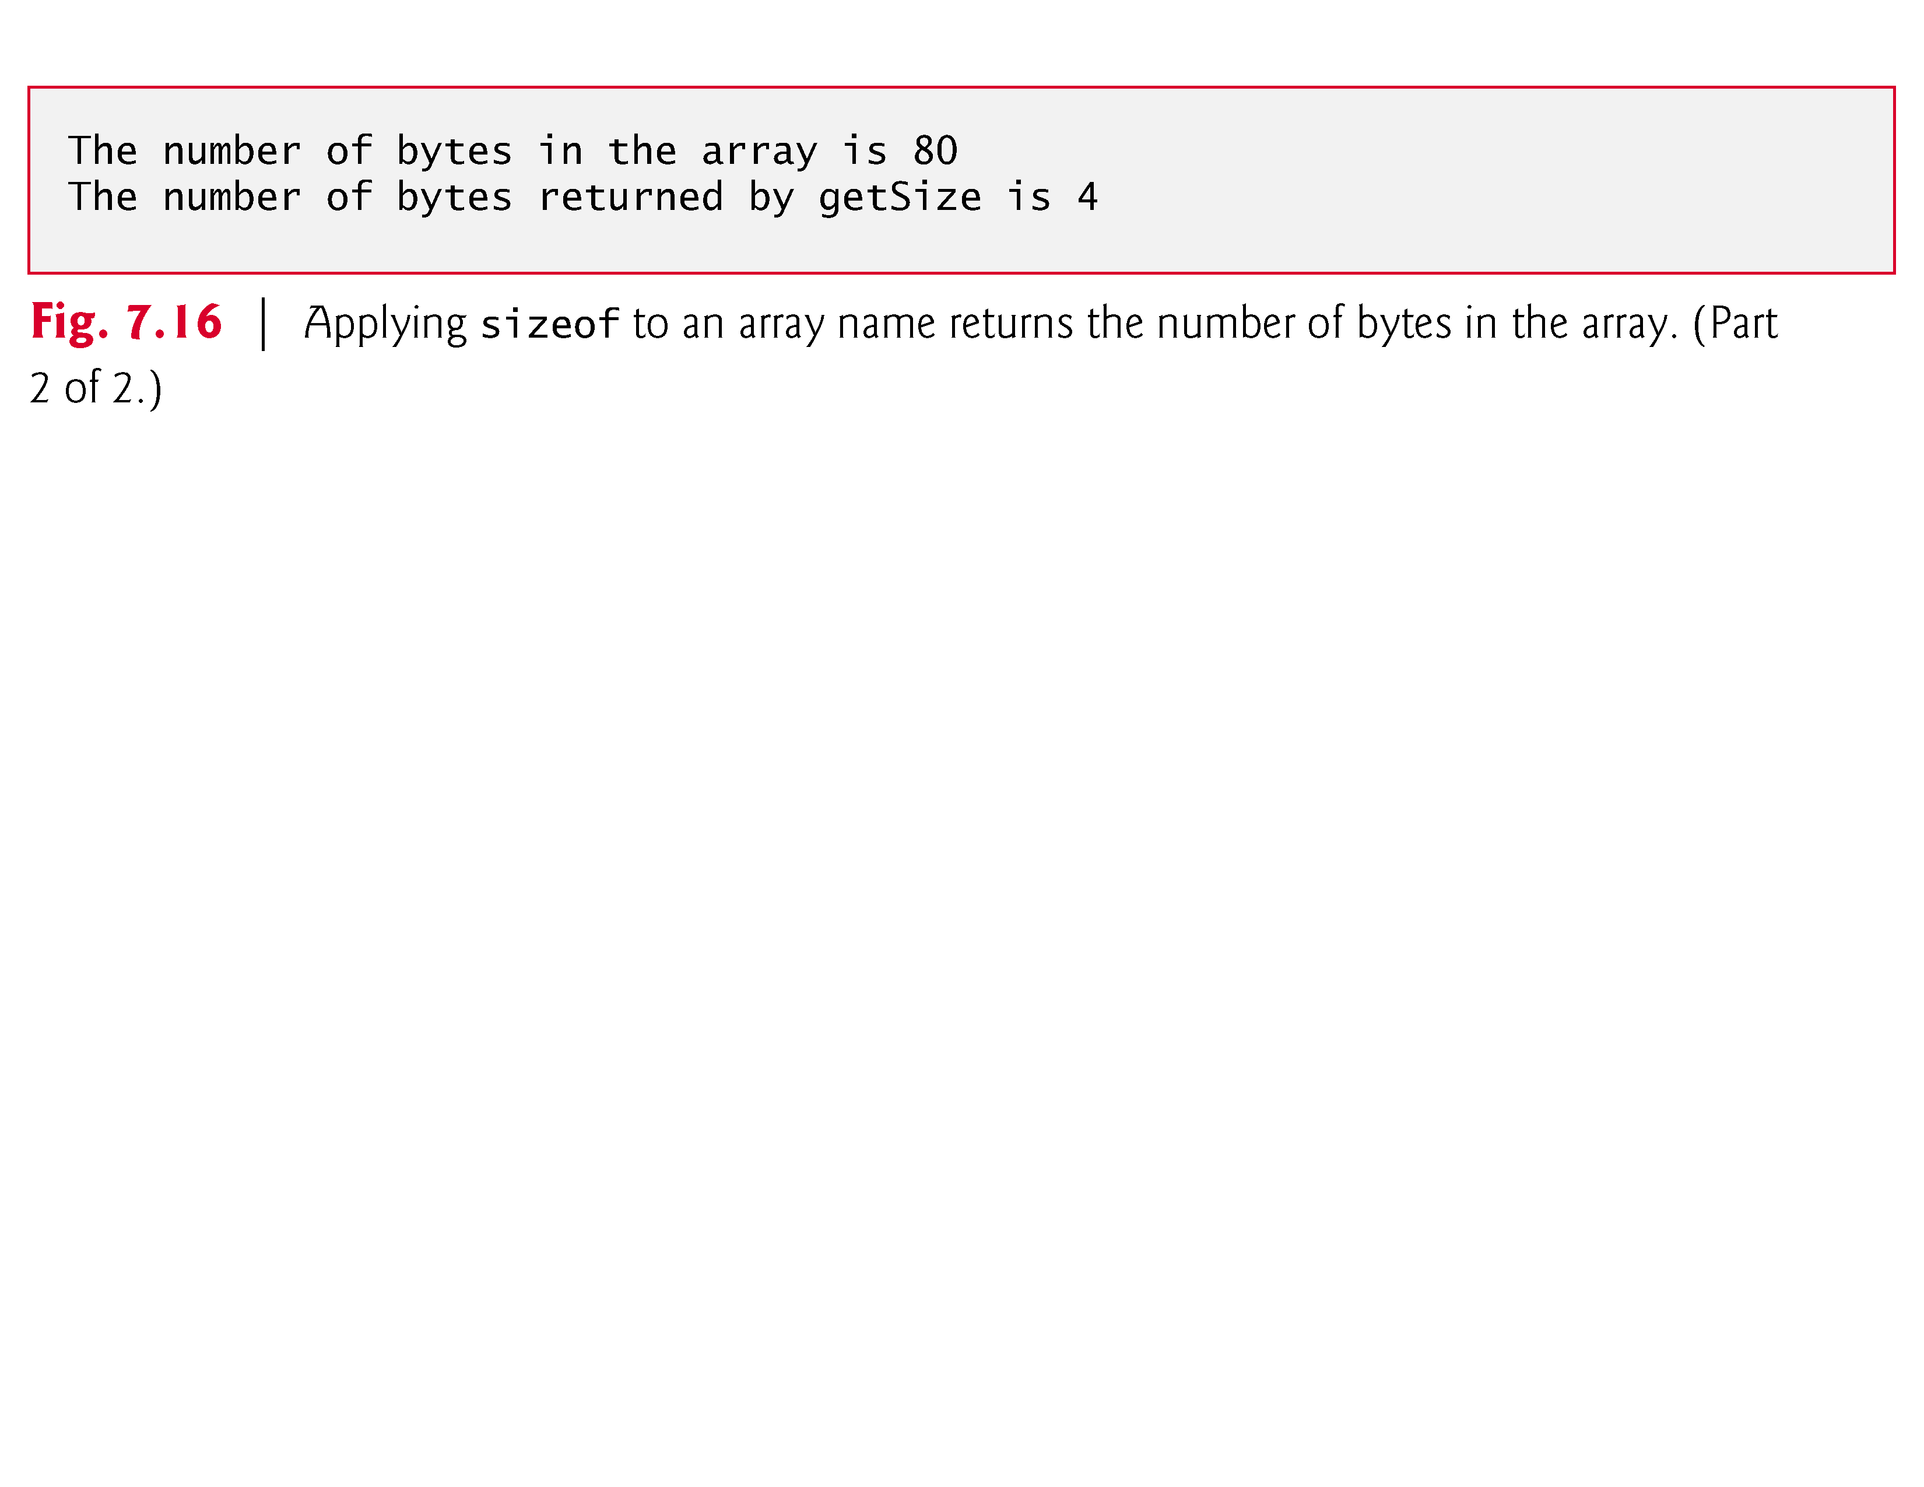

Slide 38
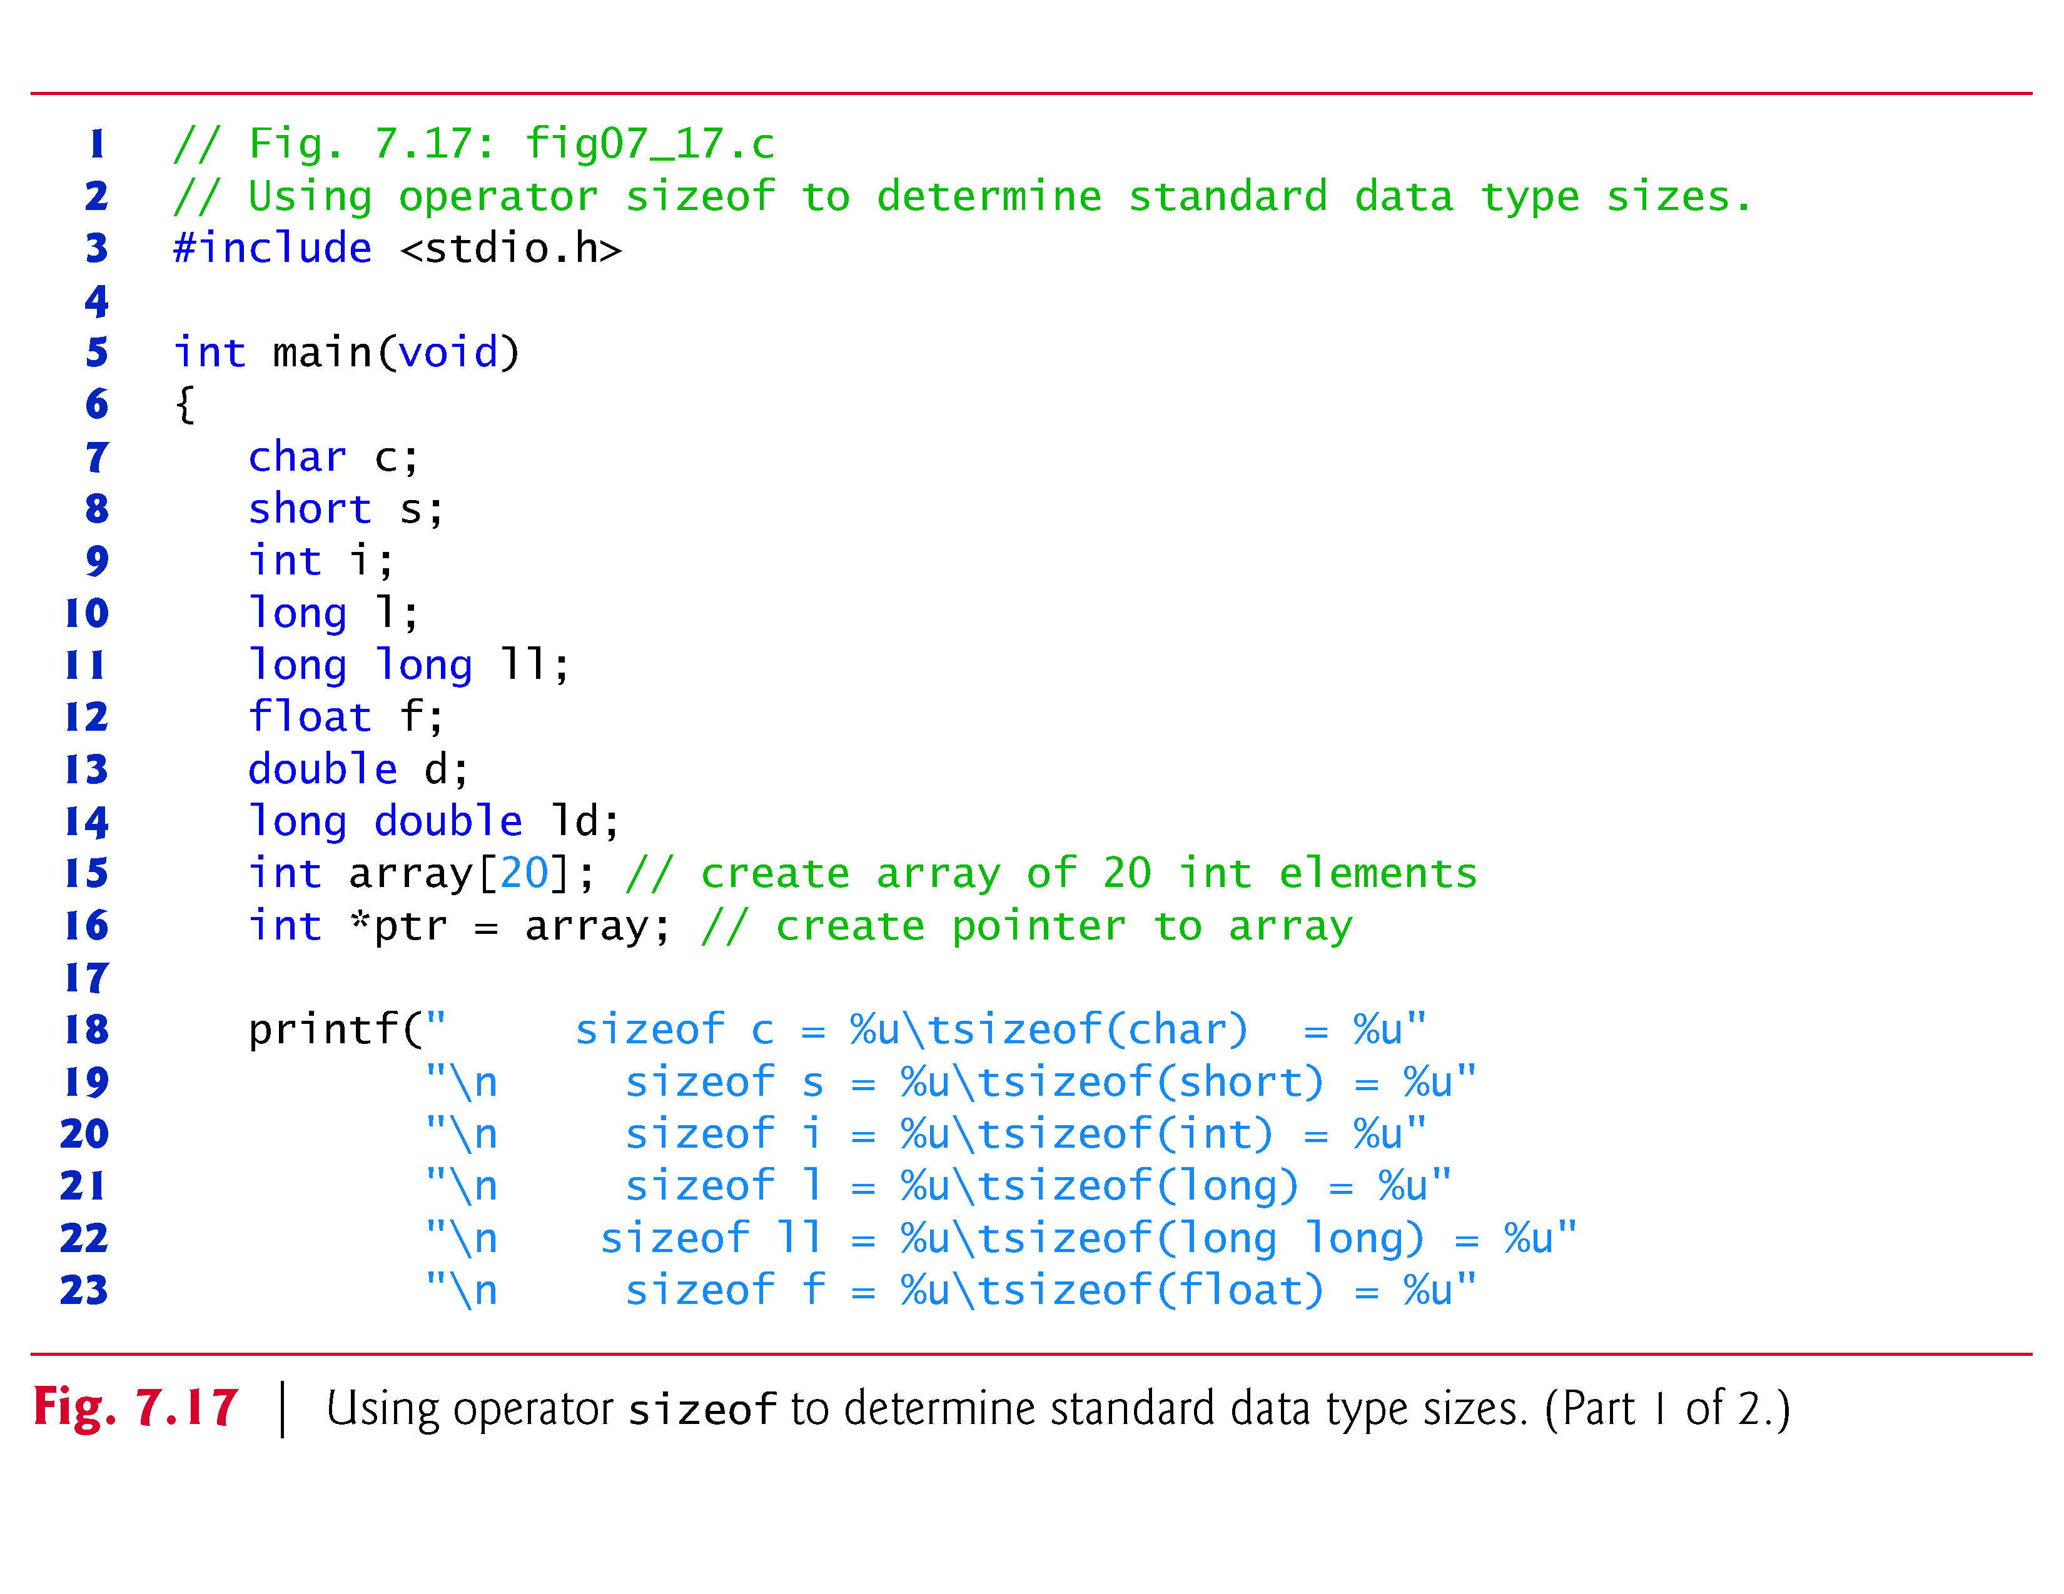

Slide 39
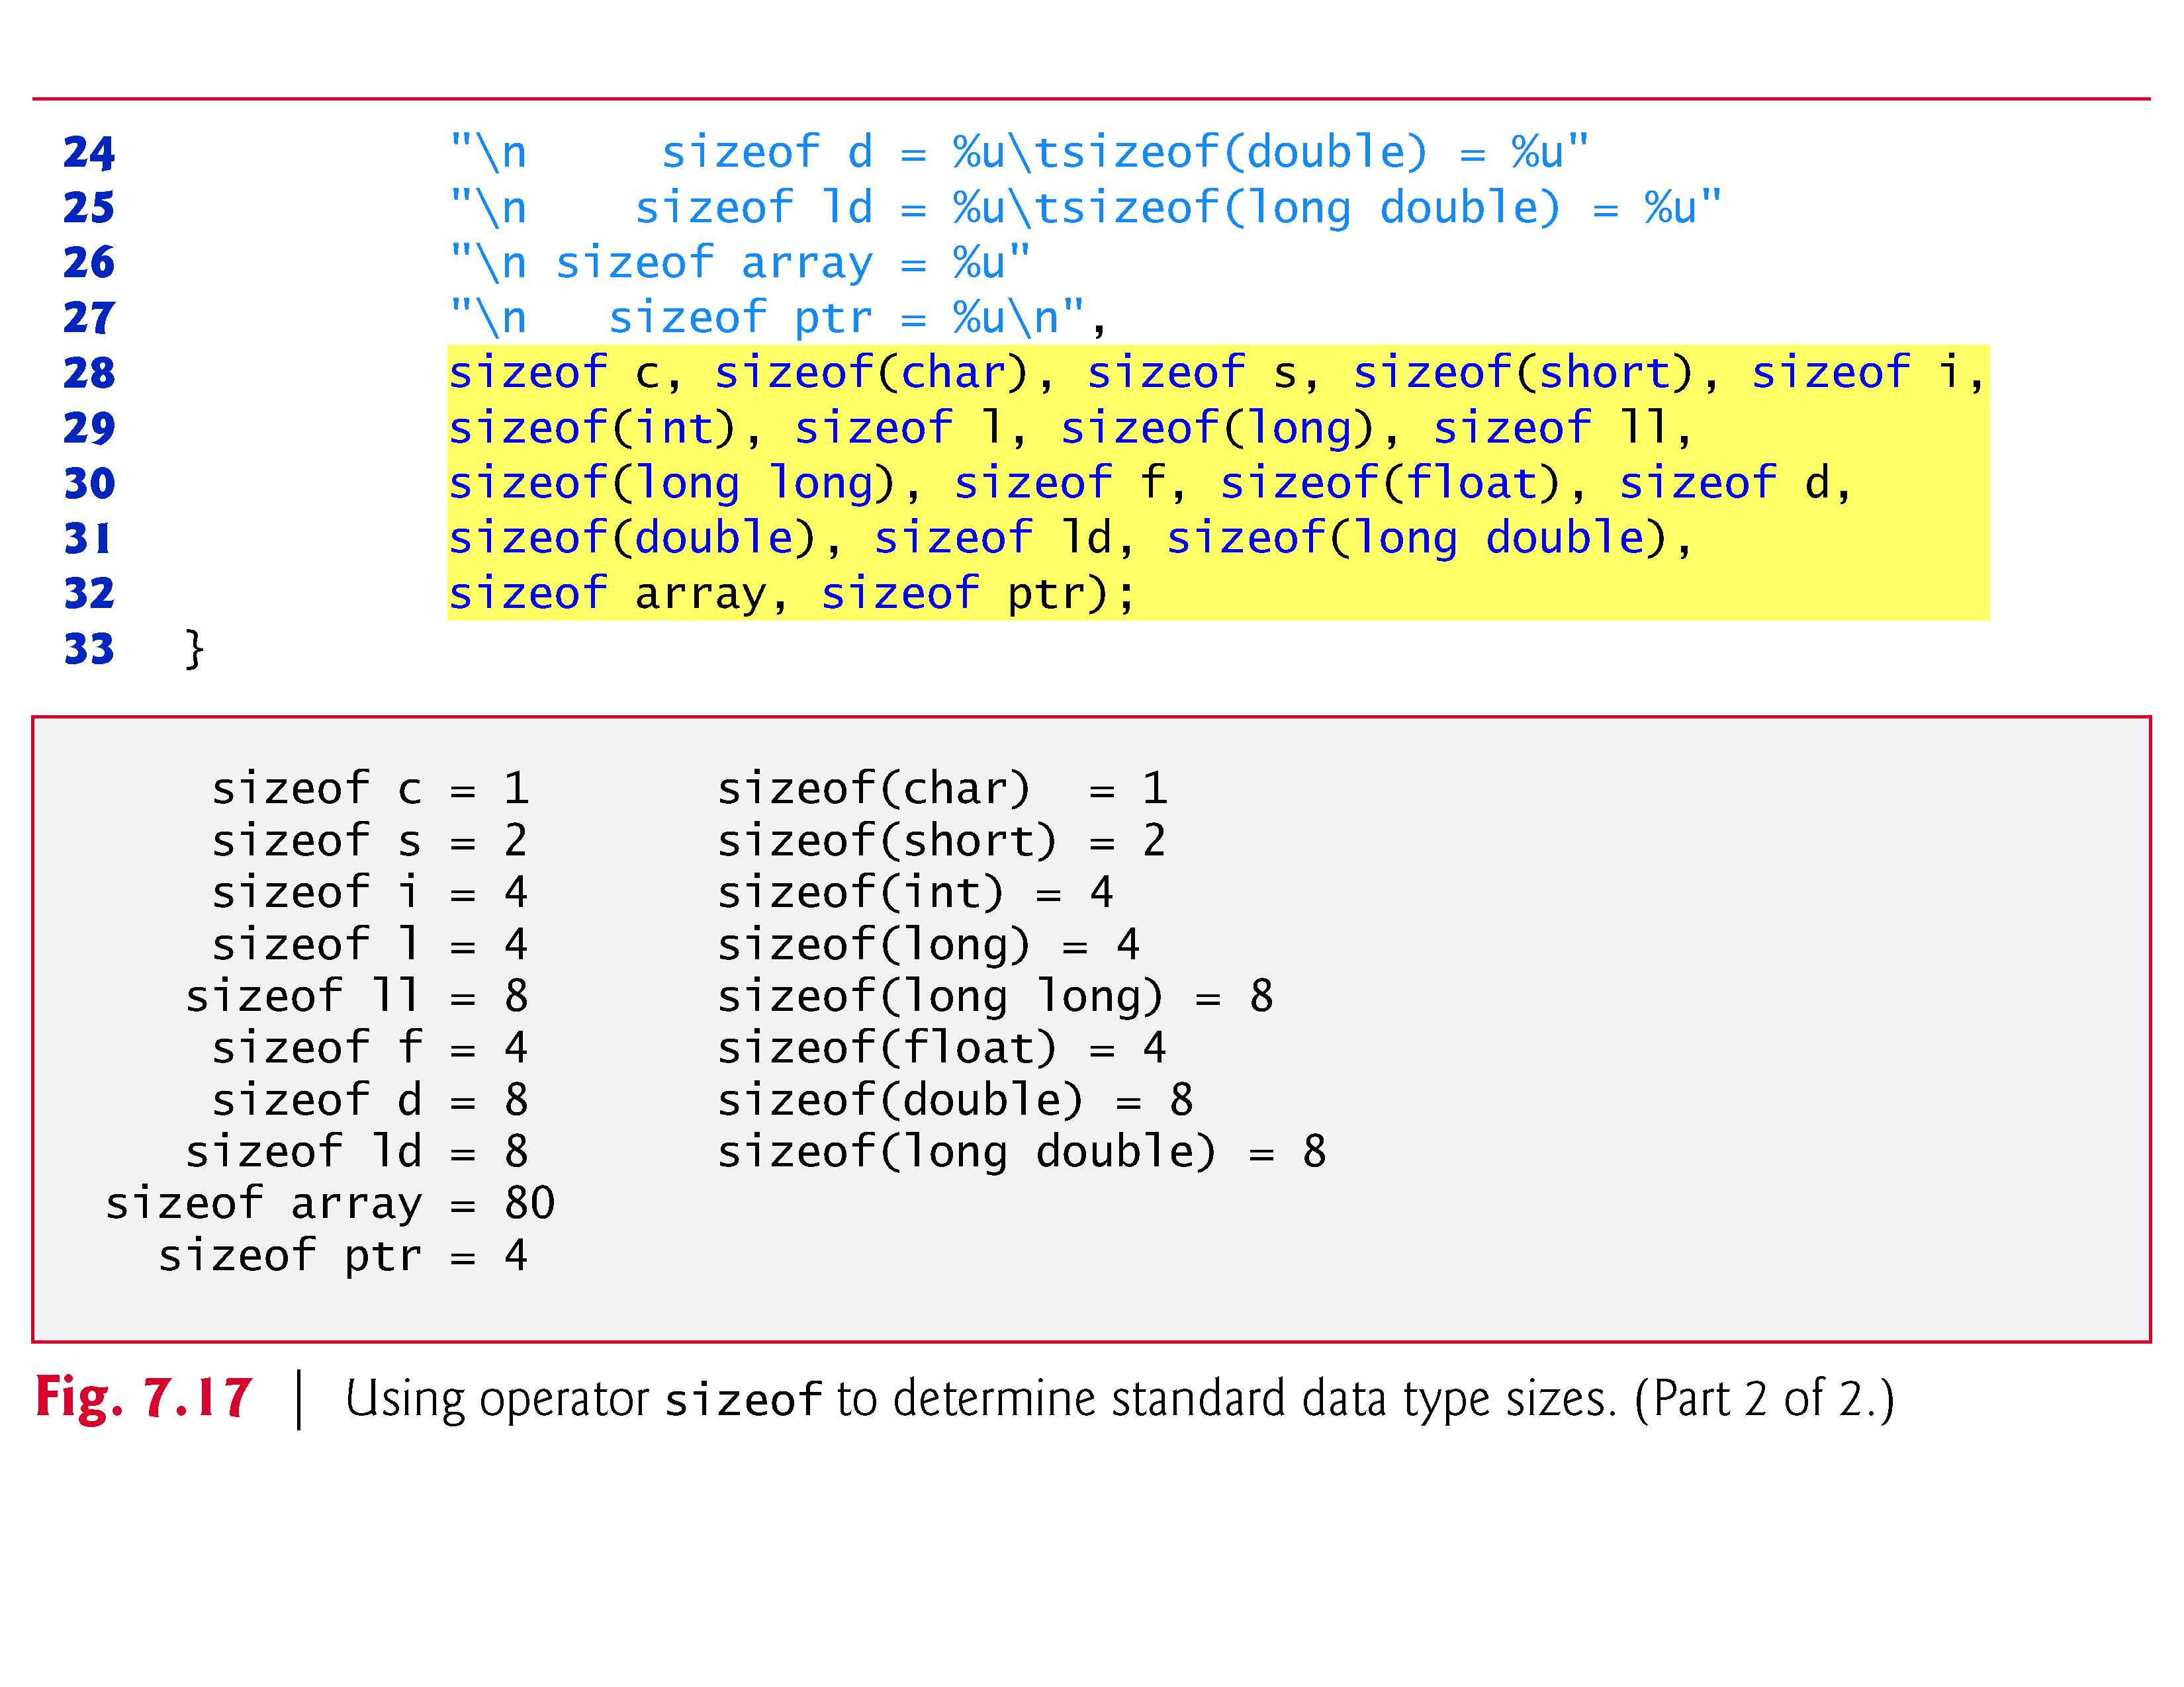

Slide 40
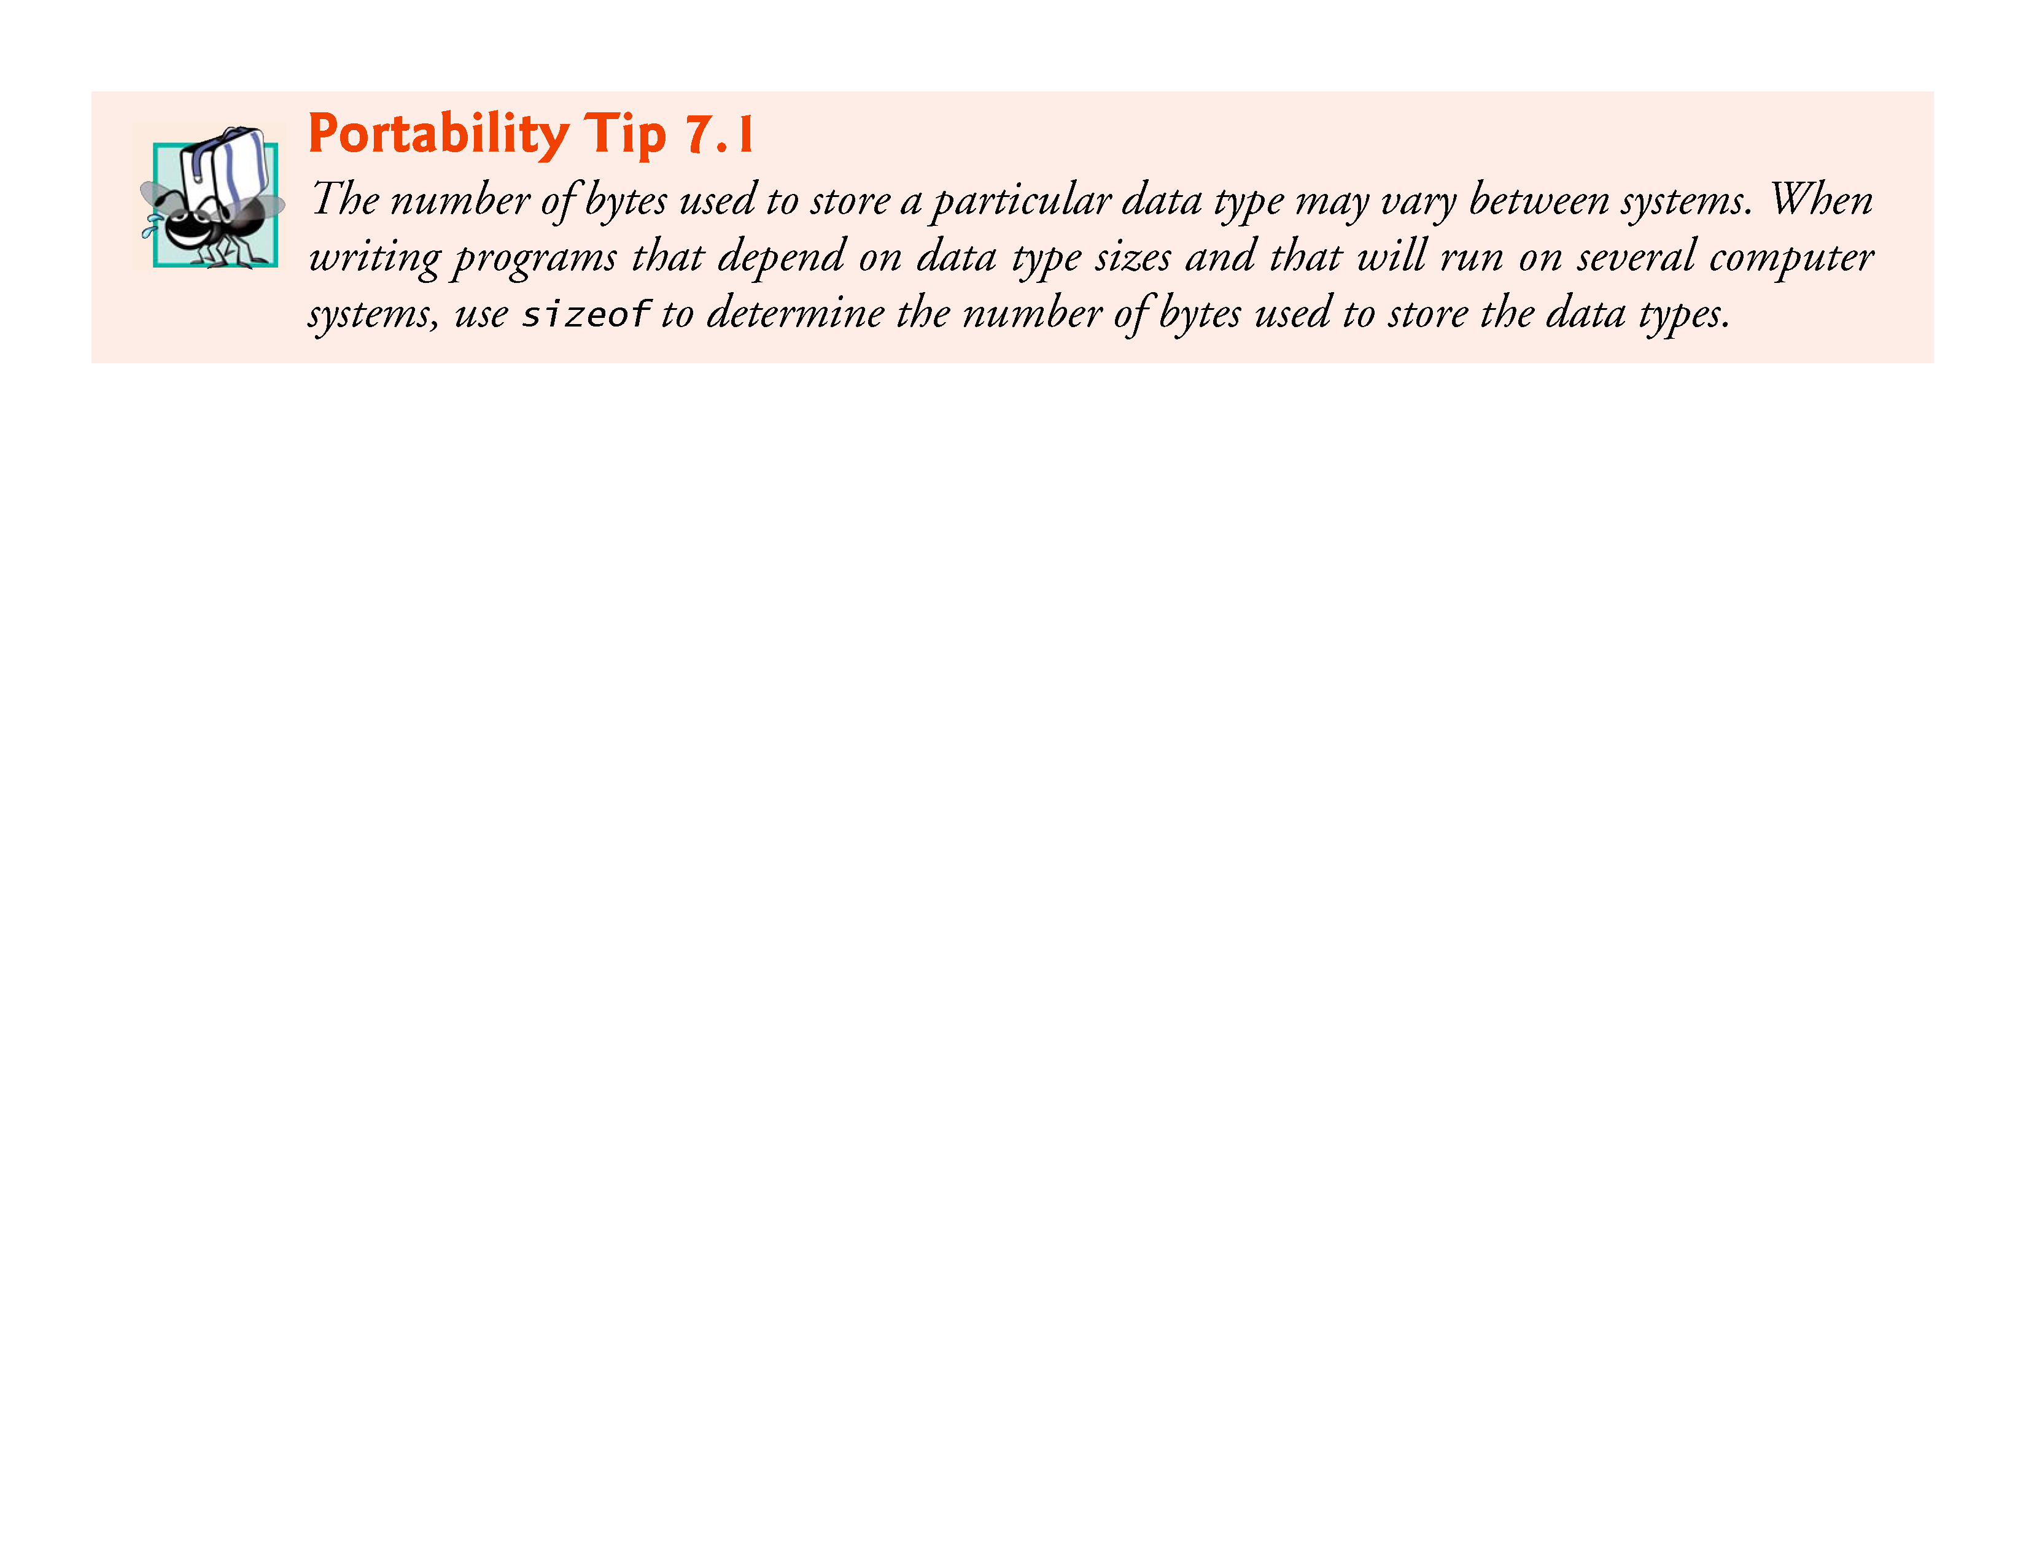

Slide 41
Pointer Expressions and Pointer Arithmetic
Arithmetic operations can be performed on pointers
Increment/decrement pointer (++ or --)
Add an integer to a pointer( + or += , - or -=)
Pointers may be subtracted from each other
Operations meaningless unless performed on an array

Slide 42
Pointer Expressions and Pointer Arithmetic
5 element int array on machine with 4 byte ints
vPtr points to first element v[ 0 ]
at location 3000 (vPtr = 3000)
vPtr += 2; sets vPtr to 3008
vPtr points to v[ 2 ] (incremented by 2), but the machine has 4 byte ints, so it points to address 3008
location
3000
3004
3008
3012
3016
v[0]
v[1]
v[2]
v[3]
v[4]
pointer variable vPtr

Slide 43
Pointer Expressions and Pointer Arithmetic
Subtracting pointers
Returns number of elements from one to the other. If
vPtr2 = v[ 2 ];
vPtr = v[ 0 ];
vPtr2 - vPtr would produce 2
Pointer comparison ( <, == , > )
See which pointer points to the higher numbered array element
Also, see if a pointer points to 0

Slide 44
Pointer Expressions and Pointer Arithmetic
Pointers of the same type can be assigned to each other
If not the same type, a cast operator must be used
Exception: pointer to void (type void *)
Generic pointer, represents any type
No casting needed to convert a pointer to void pointer
void pointers cannot be dereferenced

Slide 45
Pointers VS Arrays
Arrays and pointers closely related
Array name like a constant pointer
Pointers can do array subscripting operations
Define an array b[ 5 ] and a pointer bPtr
To set them equal to one another use:
bPtr = b;
The array name (b) is actually the address of first element of the array b[ 5 ]
bPtr = &b[ 0 ]
Explicitly assigns bPtr to address of first element of b

Slide 46
Pointers VS Arrays
Element b[ 3 ]
Can be accessed by *( bPtr + 3 )
Where n is the offset. Called pointer/offset notation
Can be accessed by bptr[ 3 ]
Called pointer/subscript notation
bPtr[ 3 ] same as b[ 3 ]
Can be accessed by performing pointer arithmetic on the array itself
*( b + 3 )

Slide 47
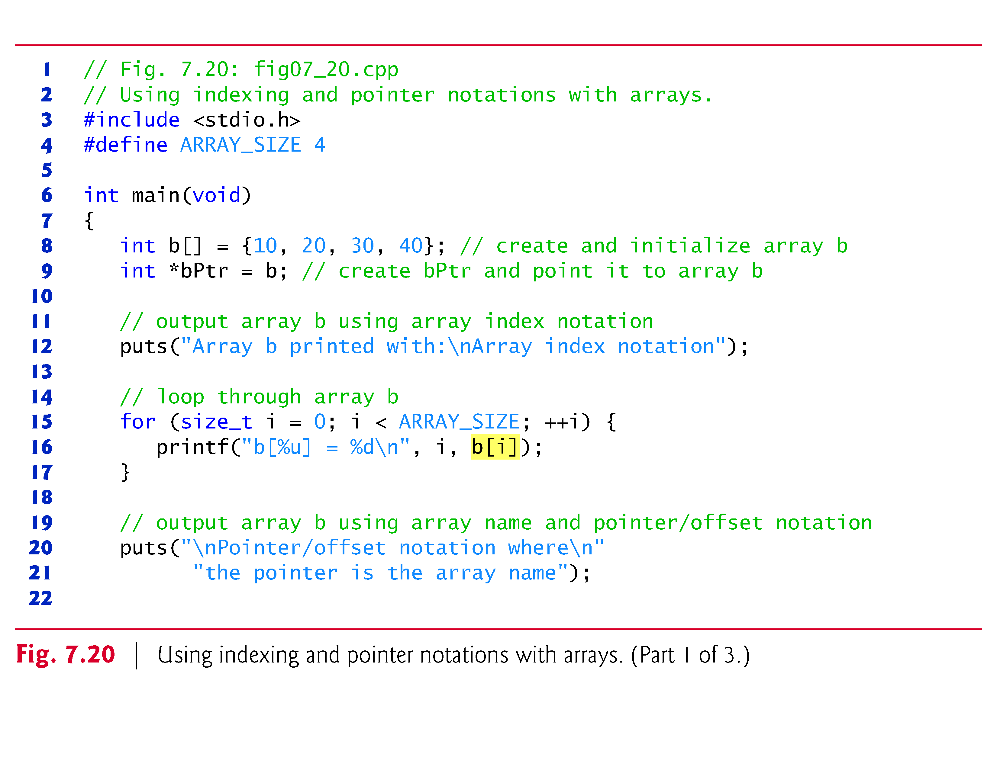

Slide 48
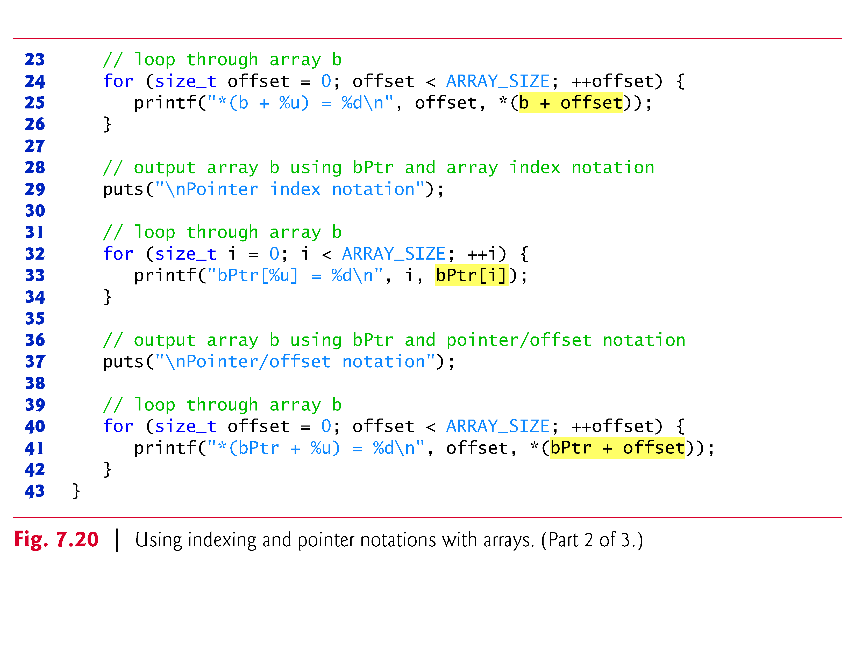

Slide 49
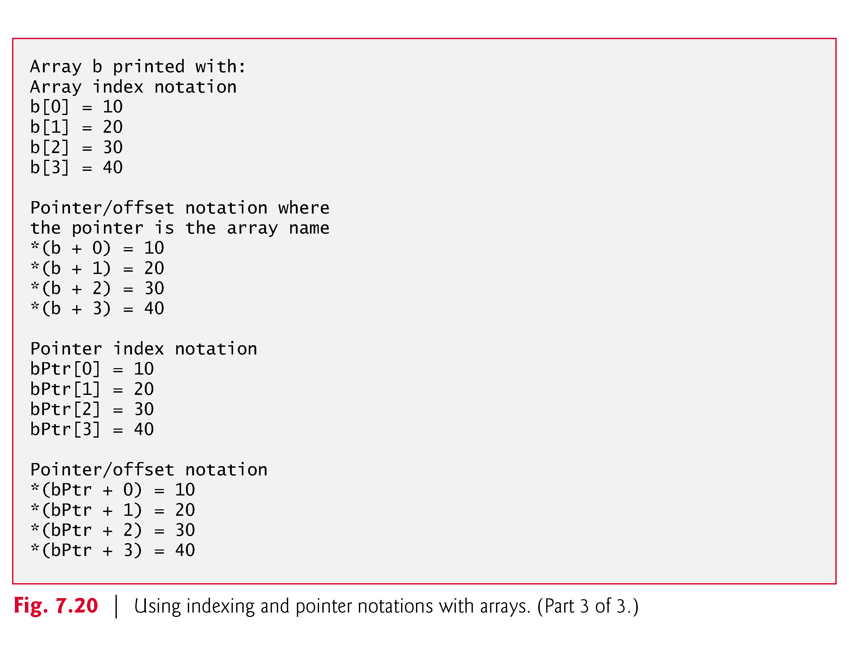

Slide 50
7.9 Relationship between Pointers and Arrays (Cont.)
String Copying with Arrays and Pointers
To further illustrate the interchangeability of arrays and pointers, let’s look at the two string-copying functions—copy1 and copy2—in the program of Fig. 7.21.
Both functions copy a string into a character array.
After a comparison of the function prototypes for copy1 and copy2, the functions appear identical.
They accomplish the same task; but they’re implemented differently.

Slide 51
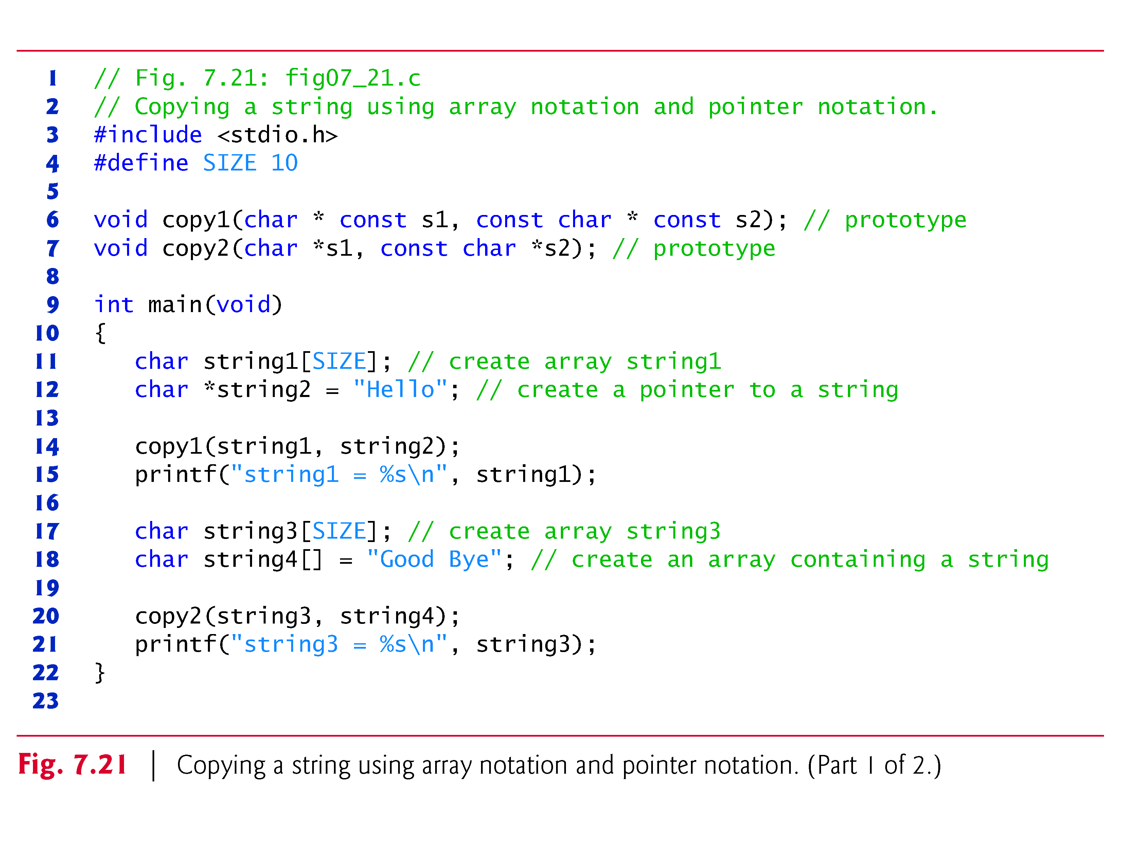

Slide 52
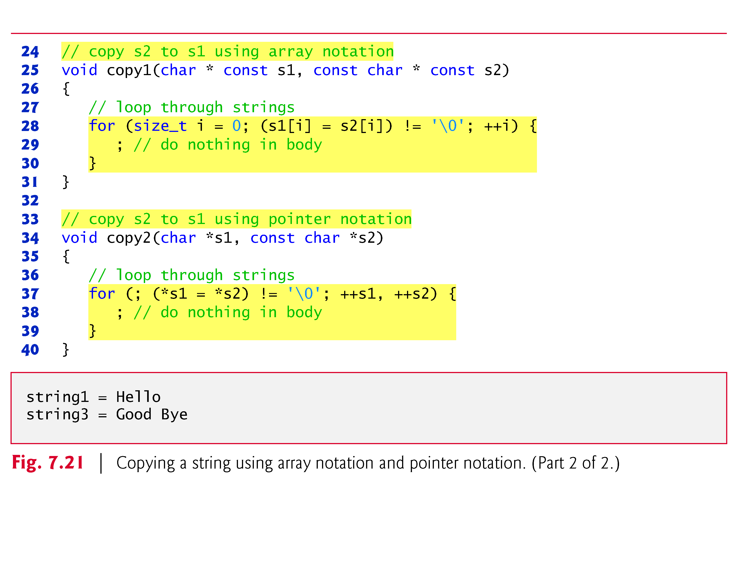

Slide 53
Arrays of Pointers
Arrays can contain pointers
For example: an array of strings
char *suit[ 4 ] = { "Hearts", "Diamonds”, "Clubs", "Spades" };
Strings are pointers to the first character
char * – each element of suit is a pointer to a char
The strings are not actually stored in the array suit, only pointers to the strings are stored
suit array has a fixed size, but strings can be of any size
suit[0]
’H’
’e’
’a’
’r’
’t’
’s’
’\0’
suit[1]
’D’
’i’
’a’
’m’
’o’
’n’
’d’
’s’
’\0’
suit[2]
’C’
’l’
’u’
’b’
’s’
’\0’
suit[3]
’S’
’p’
’a’
’d’
’e’
’s’
’\0’

Slide 54
Pointers to Functions
Pointer to function
Contains address of function
Similar to how array name is address of first element
Function name is starting address of code that defines function
Function pointers can be
Passed to functions
Stored in arrays
Assigned to other function pointers

Slide 55
Pointers to Functions
Example: bubblesort
Function bubble takes a function pointer
bubble calls this helper function
this determines ascending or descending sorting
The argument in bubblesort for the function pointer:
int ( *compare )( int a, int b )
tells bubblesort to expect a pointer to a function that takes two ints and returns an int
If the parentheses were left out:
int *compare( int a, int b )
Defines a function that receives two integers and returns a pointer to a int

Slide 56
7.11 Case Study: Card Shuffling and Dealing Simulation (Cont.)
As the deck array begins to fill with card numbers, it’s possible that a card will be selected again—i.e., deck[row] [column] will be nonzero when it’s selected.
This selection is simply ignored and other rows and columns are repeatedly chosen at random until an unselected card is found.
Eventually, the numbers 1 through 52 will occupy the 52 slots of the deck array.
At this point, the deck of cards is fully shuffled.

Slide 57
7.11 Case Study: Card Shuffling and Dealing Simulation (Cont.)
This shuffling algorithm can execute indefinitely if cards that have already been shuffled are repeatedly selected at random.
This phenomenon is known as indefinite postponement.
In this chapter’s exercises, we discuss a better shuffling algorithm that eliminates the possibility of indefinite postponement.

Slide 58
